Slide 1
New Medicare Card Project
Rural Health ODF
11/14/2017

Slide 2
Background
The Health Insurance Claim Number (HICN) is a Medicare beneficiary’s identification number, used for processing claims and for determining eligibility for services across multiple entities (e.g., Social Security Administration (SSA), Railroad Retirement Board (RRB), States, Medicare providers, and health plans)
The Medicare Access and CHIP Reauthorization Act (MACRA) of 2015 mandates the removal of the Social Security Number (SSN)-based HICN from Medicare cards to address current risk of beneficiary medical identity theft
The legislation requires that CMS mail out new Medicare cards with a new Medicare Beneficiary Identifier (MBI) by April 2019

Slide 3
Solution Concept for the New Medicare Cards
The SSN Removal solution must provide the following capabilities:
Generate Medicare Beneficiary Identifiers (MBI) for all beneficiaries: Includes existing (currently active, deceased, or archived) and new beneficiaries
Issue new, redesigned Medicare cards: New cards containing the MBI
to existing and new beneficiaries
Modify systems and business processes: Required updates to
accommodate receipt, transmission, display, and processing of the MBI
CMS will use an MBI generator to:
Assign 150 million MBIs in the initial enumeration (60 million active and 90 million deceased/archived) and generate a unique MBI for each new Medicare beneficiary
Generate a new unique MBI for a Medicare beneficiary whose identity has been compromised

Slide 4
New Medicare Number Characteristics
The Medicare Beneficiary Identifier (MBI) will have the following characteristics:
The same number of characters as the current HICN (11), but will be visibly distinguishable from the HICN
Contain uppercase alphabetic and numeric characters throughout the 11-digit identifier
Occupy the same field as the HICN on transactions
Be unique to each beneficiary (e.g., husband and wife will have their own MBI)
Be easy to read and limit the possibility of letters being interpreted as numbers (e.g., alphabetic characters are upper case only and will exclude S, L, O, I, B, Z)
Not contain any embedded intelligence or special characters
Not contain inappropriate combinations of numbers or strings that may be
offensive
CMS anticipates that the MBI will not be changed for an individual unless the MBI is compromised or other limited circumstances still undergoing review

Slide 5
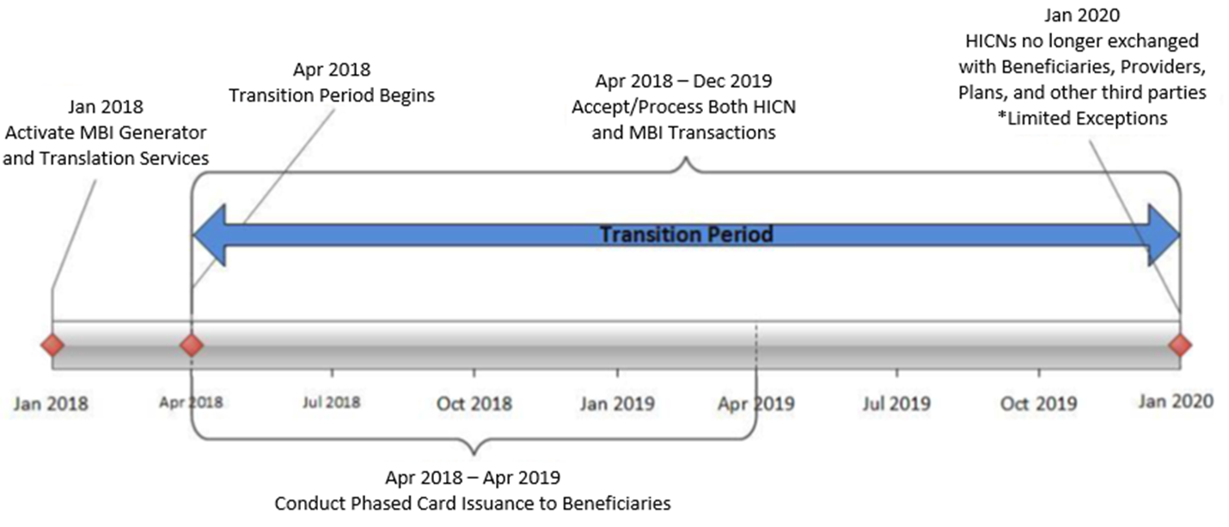
MBI Generation and Transition Period

Slide 6
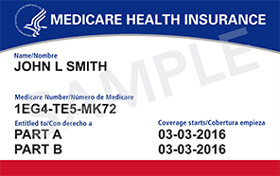
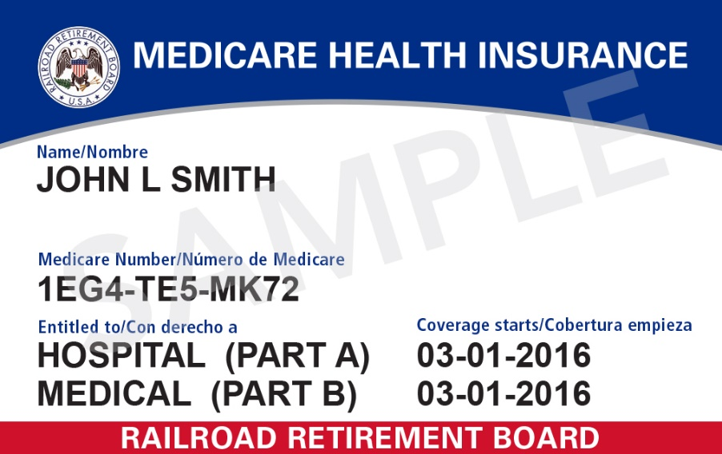
New Medicare Cards
New Medicare Card
New Railroad Retirement Board Card

Slide 7
Outreach and Education
CMS will provide outreach and education to:
  Approximately 60 million beneficiaries, their families, advocacy groups, and caregivers
  Health Plans
  The provider community (1.5M providers)
    All Provider Letter and Fact Sheet
    Quarterly Open Door Forums
  States and Territories
  Other business partners, including vendors
CMS will conduct intensive education and outreach to all Medicare beneficiaries, their families, caregivers, and advocates to help prepare for this change from September 2017 through April 2019
Once they receive their new cards, beneficiaries will be instructed to safely and securely destroy their old Medicare cards and keep the new Medicare number confidential
CMS is also working to develop a secure way for beneficiaries to be able to access their new Medicare number when needed

Slide 8
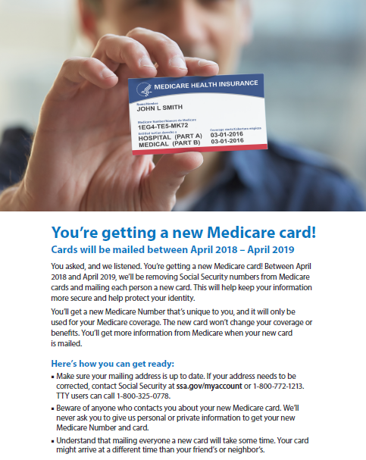
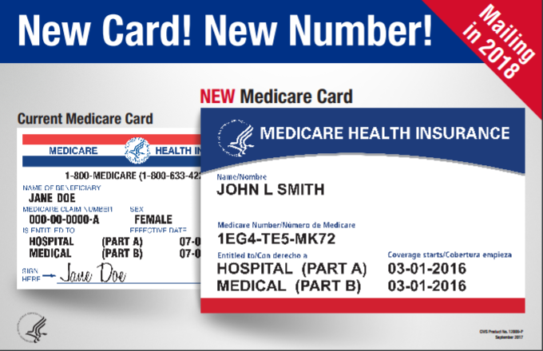
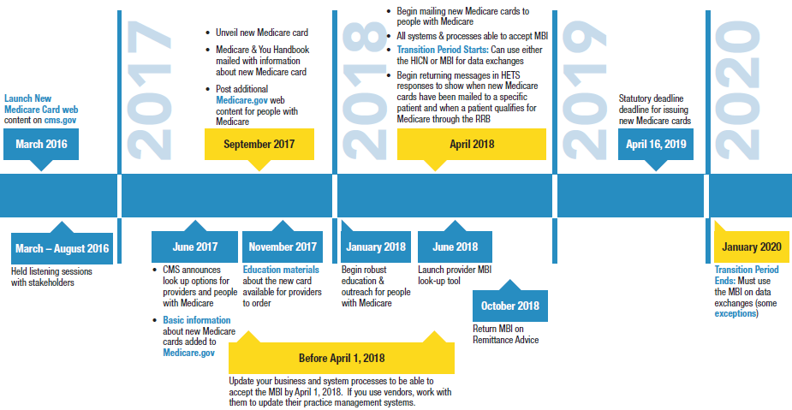
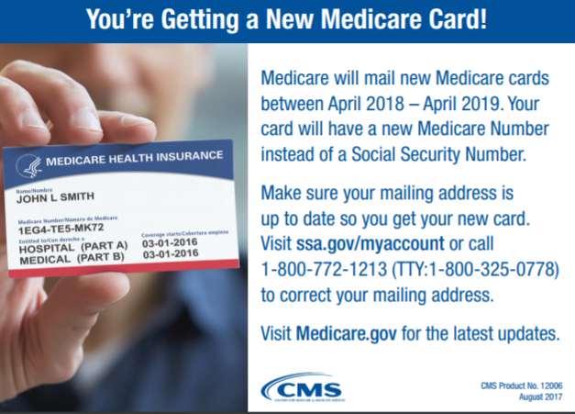
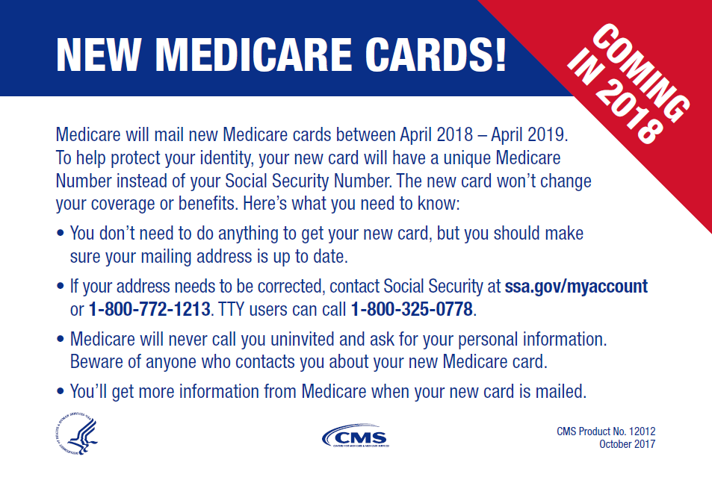
Outreach and Education Resources
Resources to help you communicate with people with Medicare are available on our website https://www.cms.gov/newcard to print and/or order
A Flyer to Distribute
A Poster for Providers’ Offices
A Full Timeline for Your Records
Tear-offs for Patients
Conference Cards for Beneficiaries

Slide 9
Key Points to Reinforce with Patients
Understand that mailing everyone a new card will take some time. Your card might arrive at a different time than your friend’s or neighbor’s.
Make sure your mailing address is up-to-date. If your address needs to be corrected, contact Social Security at ssa.gov/myaccount or 1-800-772-1213. TTY: 1-800-325-0778.
Beware of anyone who contacts you about your new Medicare card. We will never ask you to give us personal or private information to get your new Medicare number and card.

Slide 10
Key Points to Know
Providers need to be ready by April 1, 2018 (systems and business processes)
There will be a 21- month transition period from April 1, 2018 – December 31, 2019
Providers will have 3 ways to get the new MBI:
  Patient presents the card at time of service
  Provider receives it through the remittance advice
  Provider obtains it through the a secure web portal with the MAC
Providers have resources you can use when you talk to people with Medicare about the new Medicare cards: https://www.cms.gov/Medicare/New-Medicare-Card/Partners-and-Employers/Partners-and-employers.html

Slide 11
Final Thoughts
Thank you for participating today.
For the most updated information on the New Medicare Card please go to https://www.cms.gov/newcard
Please submit any additional comments or questions to the New Medicare Card team mailbox: NewMedicareCardSSNRemoval@cms.hhs.gov

