Slide 1
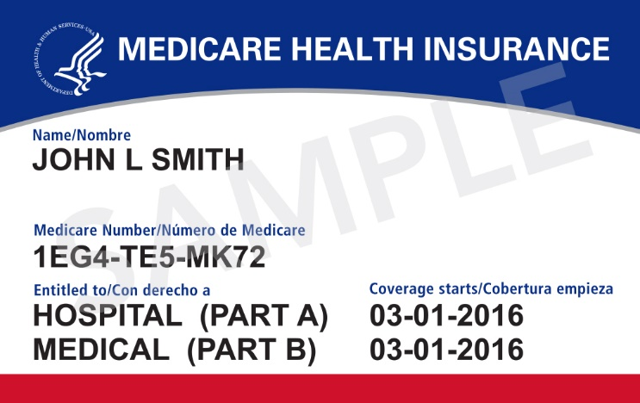
New Medicare Card
Information for Partners & Stakeholders
May 2018

Slide 2
Background
The Health Insurance Claim Number (HICN) is a Medicare beneficiary’s identification number, used for processing claims and determining eligibility for services across multiple entities (e.g., Social Security Administration (SSA), Railroad Retirement Board (RRB), States, Medicare providers & health plans)
The Medicare Access and CHIP Reauthorization Act (MACRA) of 2015 requires removal of the Social Security Number (SSN)-based HICN from Medicare cards to address current risk of beneficiary medical identity theft
MACRA requires that CMS mail out new Medicare cards with a new Medicare Number by April 2019
The new Medicare numbers won’t change Medicare benefits. People with Medicare can start using their new Medicare cards right away.

Slide 3
New Unique Medicare Number
New Medicare Number
  New Non-Intelligent Unique Identifier
  11 bytes
  Key positions 2, 5, 8 & 9
  will always be alphabetic

Slide 4
Sending New Medicare Cards
Medicare started mailing new cards in April 2018
  Newly-eligible beneficiaries will get a card with a unique number, regardless of where they live
  Existing beneficiaries will get a new card over a period of approximately 12 months
  Distribution of cards to existing beneficiaries will be randomized by geographic location, with states grouped into one of seven “waves”
In April, CMS launched Medicare.gov/newcard where people with Medicare can sign up for emails about the card mailing and check the card mailing status in their state
People with Medicare should use the new card once they get it, but either the SSN-based or the new random alphanumeric-based numbers can be used through December 2019
Beginning January 1, 2020 only the new card will be usable

Slide 5
New Medicare Card Mailing
Wave | States Included | Cards Mailing
Newly Eligible People with Medicare | All – Nationwide | April 2018 - Ongoing
1 | Delaware, District of Columbia, Maryland, Pennsylvania, Virginia, West Virginia | Mailing started: May 2018
2 | Alaska, American Samoa, California, Guam, Hawaii, Northern Mariana Islands, Oregon | Beginning May 2018
3 | Arkansas, Illinois, Indiana, Iowa, Kansas, Minnesota, Nebraska, North Dakota, Oklahoma, South Dakota, Wisconsin | After June 2018
4 | Connecticut, Maine, Massachusetts, New Hampshire, New Jersey, New York, Rhode Island, Vermont | After June 2018
5 | Alabama, Florida, Georgia, North Carolina, South Carolina | After June 2018
6 | Arizona, Colorado, Idaho, Montana, Nevada, New Mexico, Texas, Utah, Washington, Wyoming | After June 2018
7 | Kentucky, Louisiana, Michigan, Mississippi, Missouri, Ohio, Puerto Rico, Tennessee, Virgin Islands | After June 2018
https://www.cms.gov/Medicare/New-Medicare-Card/NMC-Mailing-Strategy.pdf

Slide 6
New Medicare Card Awareness Survey Strategy
Pre-Outreach Baseline: Early January 2018, National Sample
  Between periods of active outreach, awareness levels may decline, so this effort helped establish a new baseline measure
Implementation Wave 1: Early to Mid April 2018, National + Local Oversample
  This survey helps compare awareness as mailings begin to baseline and to later implementation states. Early results indicate that awareness is holding steady from earlier timeframes.
  Receipt of the New Card should improve awareness substantially, as direct mail has been shown to be an effective outreach strategy.
Implementation Wave 2: Summer 2018, National + Local Oversample
  This survey will examine the extent to which alterations in outreach messaging and strategy improve awareness, along with targeted local communications

Slide 7
Your Guide for Outreach
  January – October 2018
    National Outreach with drumbeat messaging, changing over time
    Dial up the outreach and messaging! Card mailing moves to forefront of messaging for people with Medicare through all communications channels.
      January 25 to Mid-April:
        Messaging about mailing address accuracy and protection from fraudsters
      Mid-April – October:
        Intensive earned media and local outreach kicks off, coordinated with card mailing
        Messaging about when to expect new cards, what to do with old (and new) cards, what to do if you don’t receive a card or need help, and being aware of potential scams

Slide 8
Your Guide for Outreach (continued)
Specific messaging for people with Medicare
January to Mid-April
New Medicare cards with new Medicare Numbers are coming
Make sure the Social Security Administration has your current mailing address
Beware of scam artists contacting you about your new card
Mid-April to October
MAILING BEGINS!
Find out when your card is mailed by visiting Medicare.gov and signing up for email
What to do if you don’t get your card
Destroy your old card (shred)
Once your card has been mailed, you can look up your Medicare Number or print a card on MyMedicare.gov
Continue to be alert and watch for fraud

Slide 9
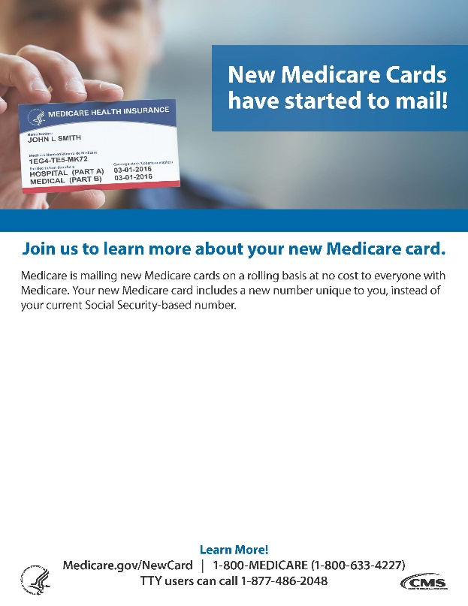
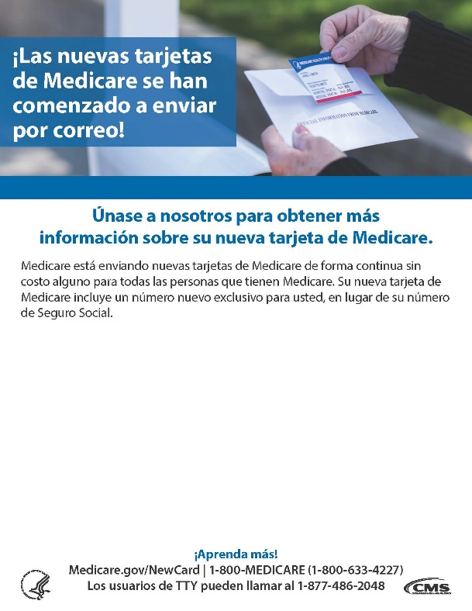
Outreach & Education Materials – Fillable Flyers
https://www.cms.gov/Medicare/New-Medicare-Card/Outreach-and-Education/Products-to-share-with-beneficiaries.html

Slide 10





Outreach & Education Materials – Updated Widgets

Slide 11
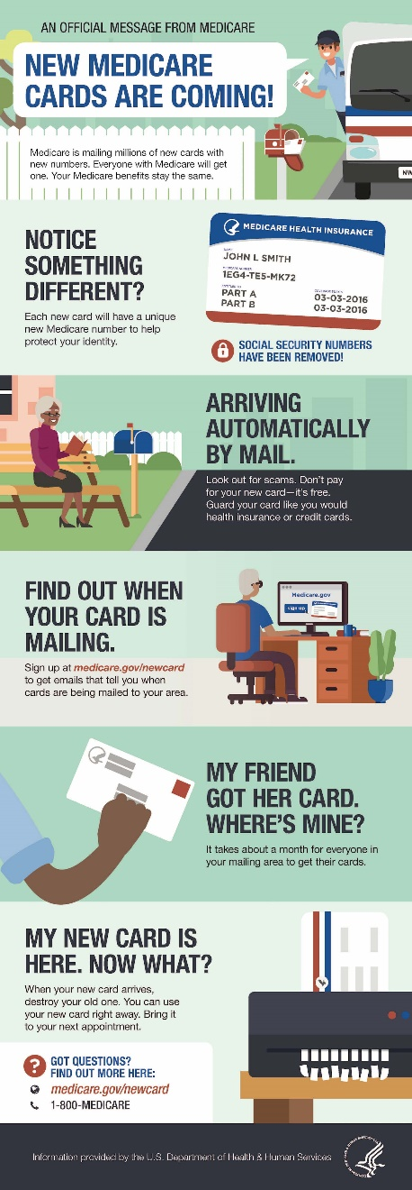
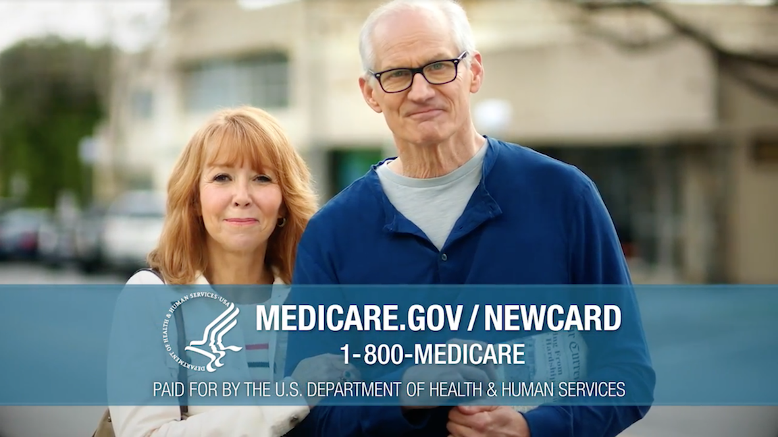
Outreach & Education Materials – Graphic & PSA

Slide 12

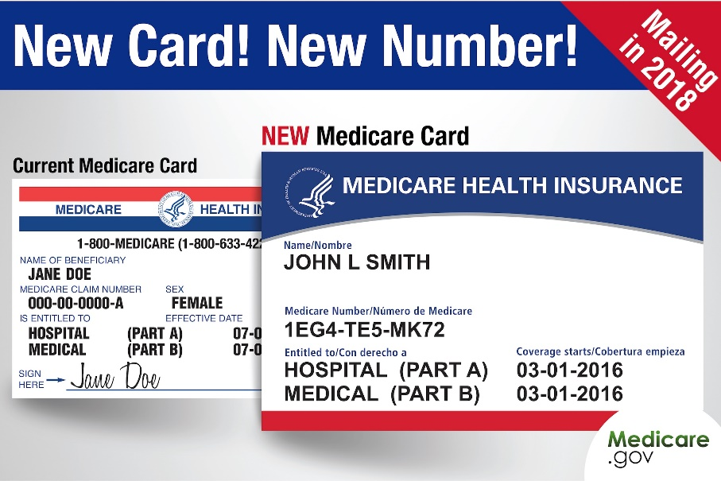

Outreach & Education Materials – Social Media Guide

Slide 13
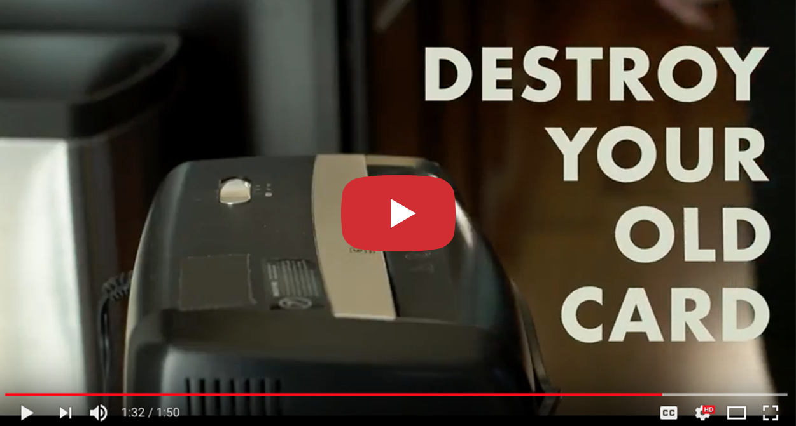
Outreach & Education Materials – New Video
https://youtu.be/Rf9q0dVinF8

Slide 14
Stay Connected
Medicare.gov/NewCard
New Card destination for people with Medicare. Sign up for email alerts and view map to see where cards are mailing.
CMS.gov/NewCard
Top source for providers, partners and stakeholders. Find technical guidance, presentations, and outreach materials.
Productordering.cms.hhs.gov
Create an account and order free Medicare brochures, posters, and other education and outreach materials on new Medicare cards and other topics.
Comments and questions are always welcome! Send to: NewMedicareCardSSNRemoval@cms.hhs.gov

