Slide 1
New Medicare Card Project
Plan User Call
1/24/2018

Slide 2
Background
The Health Insurance Claim Number (HICN) is a Medicare beneficiary’s identification number, used for processing claims and for determining eligibility for services across multiple entities (e.g., Social Security Administration (SSA), Railroad Retirement Board (RRB), States, Medicare providers, and health plans)
The Medicare Access and CHIP Reauthorization Act (MACRA) of 2015 mandates the removal of the Social Security Number (SSN)-based HICN from Medicare cards to address current risk of beneficiary medical identity theft
The legislation requires that CMS mail out new Medicare cards with a new Medicare Beneficiary Identifier (MBI) by April 2019

Slide 3
Operational Goals
Primary Operational Goal: To decrease Medicare Beneficiary vulnerability to identity theft by removing the SSN-based number from their Medicare identification cards and replace with a new unique Medicare Number
In achieving this goal CMS seeks to:
  Minimize burdens for beneficiaries
  Minimize burdens for providers
  Minimize disruption to Medicare operations
  Provide a solution to our business partners that allows usage of HICN
and/or new Medicare Number for business critical data exchanges
  Manage the cost, scope, and schedule for the project

Slide 4
Complex IT Systems affecting Providers, Partners, and Beneficiaries
Along with our partners, CMS will address complex systems changes for over 75 systems, conduct extensive outreach & education activities and analyze the many changes that will be needed to systems and business processes
Affected stakeholders include:
  Federal partners, States, Beneficiaries, Providers, and Plans
  Other key stakeholders, such as billing agencies, advocacy groups, data warehouses, etc.
CMS has been working closely with partners and stakeholders to implement the New Medicare Card Initiative

Slide 5
Implementation of New Medicare Numbers

Slide 6
Solution Concept for the New Medicare Cards
The SSN Removal solution must provide the following capabilities:
Generate Medicare Beneficiary Identifiers (MBI) for all beneficiaries: Includes existing (currently active, deceased, or archived) and new beneficiaries
Issue new, redesigned Medicare cards: New cards containing the MBI
to existing and new beneficiaries
Modify systems and business processes: Required updates to
accommodate receipt, transmission, display, and processing of the MBI
CMS will use an MBI generator to:
Assign 150 million MBIs in the initial enumeration (60 million active and 90 million deceased/archived) and generate a unique MBI for each new Medicare beneficiary
Generate a new unique MBI for a Medicare beneficiary whose identity has been compromised

Slide 7
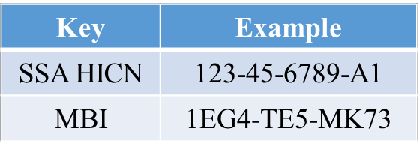
HICN and MBI Number
Health Insurance Claim Number (HICN)
Primary Beneficiary Account Holder Social Security Number (SSN) plus Beneficiary Identification Code (BIC)
9-byte SSN plus 1 or 2-byte BIC
Key positions 1-9 are numeric
Note: Identifiers are fictitious and dashes for display purposes only; they are not stored in the database nor used in file formats
Medicare Beneficiary Identifier (MBI)
New Non-Intelligent Unique Identifier
11 bytes
Key positions 2, 5, 8, and 9 will always be alphabetic

Slide 8
New Medicare Number Characteristics
The Medicare Beneficiary Identifier (MBI) will have the following characteristics:
The same number of characters as the current HICN (11), but will be visibly distinguishable from the HICN
Contain uppercase alphabetic and numeric characters throughout the 11-digit identifier
Occupy the same field as the HICN on transactions
Be unique to each beneficiary (e.g., husband and wife will have their own MBI)
Be easy to read and limit the possibility of letters being interpreted as numbers (e.g., alphabetic characters are upper case only and will exclude S, L, O, I, B, Z)
Not contain any embedded intelligence or special characters
Not contain inappropriate combinations of numbers or strings that may be
offensive
CMS anticipates that the MBI will not be changed for an individual unless the MBI is compromised

Slide 9
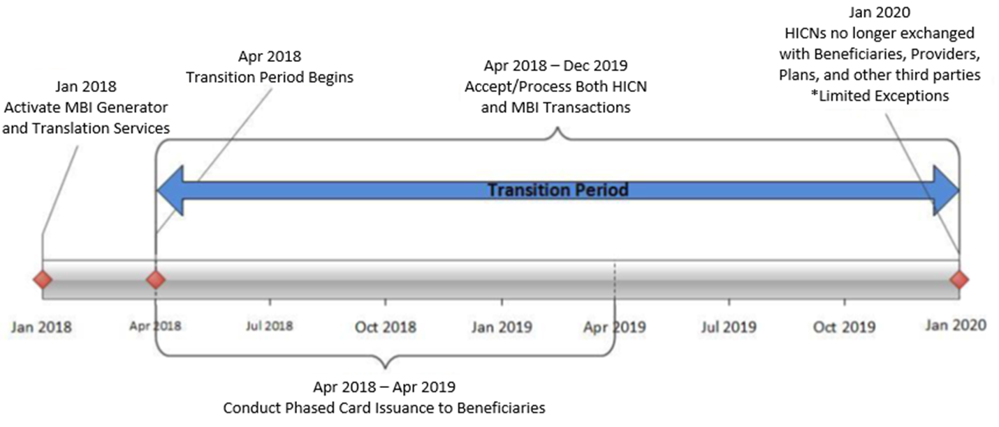
MBI Generation and Transition Period

Slide 10
Using the New Medicare Number – During Transition
The transition period will run from April 2018 through December 31, 2019
CMS will complete its system and process updates to be ready to accept
and return the MBI on April 1, 2018
All stakeholders who submit or receive transactions containing the HICN must modify their processes and systems to be ready to submit or exchange the MBI by April 1, 2018. Stakeholders may submit either the MBI or HICN during the transition period
CMS will accept, use for processing, and return to stakeholders either the
MBI or HICN, whichever is submitted on the claim, during the transition period
CMS will actively monitor use of HICNs and MBIs during the transition period to ensure that everyone is ready to use MBIs only by January 1, 2020

Slide 11
Using the New Medicare Number – During Transition (2)
CMS is making systems changes so that when a provider checks a beneficiary’s eligibility, the CMS HIPAA Eligibility Transaction System (HETS) will return a message on the response indicating that CMS mailed that particular beneficiary’s new Medicare card
Beginning October 2018 through the end of the transition period, when a valid and active HICN is submitted on Medicare fee-for-service claims both the HICN and the MBI will be returned on the remittance advice
  The MBI will be in the same place you currently get the “changed HICN”: 835 Loop 2100, Segment NM1 (Corrected Patient/Insured Name), Field NM109 (Identification Code)
Use of HICN and MBI for the same person with Medicare on the same batch of claims
  During the transition period, we’ll process all claims with either the HICN or MBI, even when both are in the same batch

Slide 12
Using the New Medicare Number – During Transition (3)
Medicaid and supplemental insurers
  We will give State Medicaid Agencies and supplemental insurers the MBIs for Medicaid-eligible people who also have Medicare before we mail the new Medicare cards. During the transition period, we’ll process and transmit Medicare crossover claims with either the HICN or MBI
Railroad Retirement Board (RRB) beneficiaries
  The RRB will continue to send cards with the RRB logo, but you can’t tell from looking at the MBI if beneficiaries are eligible for Medicare because they’re railroad retirees
  Beginning in April 2018, we’ll return a message on the eligibility transaction response for a RRB patient. The message will say, "Railroad Retirement Medicare Beneficiary.
    271 Loop 2110C, Segment MSG
  Medicare Providers must program their systems to identify RRB beneficiaries so they know to send those claims to the Specialty Medicare Administrative Contractor (SMAC)

Slide 13
Using the New Medicare Number – During Transition (4)
Private payers
  For non-Medicare business, private payers won’t have to use the MBI. We’ll continue to use supplemental insurer’s unique numbers to identify customers, but after the transition period, supplemental insurers must use the MBI for any Medicare transactions where they would have used the HICN
In addition, CMS is working to develop capabilities where providers will be able to access a beneficiary’s MBI through a secure look up tool at the point of service
  In instances in which a beneficiary does not have a new Medicare card at the point of care, we believe this look up tool will give providers a mechanism to access a beneficiary’s MBI securely without disrupting workflow

Slide 14
Preparing Third Party Group Payer (TPG) Systems
Effective January 1, 2020, CMS will discontinue the use of the HICN in the Third Party System (TPS) Medicare premium billing data exchange for billing Group Payers‘ Medicare premiums and will replace it with the MBI
The transition period enables TPG Payers to fully comply with the new data exchange process with TPS, allowing submission of either the MBI or the HICN
  However, after the transition period—as of January 1, 2020, TPG Payers must use the MBI for any Medicare transactions where they would have used the HICN
This month, CMS will generate test load files for these 147 other groups, containing up to 25 beneficiary records for each, with test MBIs.
  These will be in the form of EXCEL spreadsheets to be sent as secure attachments.
  The Office of Financial Management (OFM) is not yet certain all of the groups will be able to receive an email with an EXCEL file attachment, as most do not send/receive these spreadsheets today.
  OFM may still want to conduct test data exchanges before 04/01/2018.

Slide 15
New Medicare Number Exceptions
After the Transition Period
  Beneficiaries, providers, and plans will no longer use the HICN for internal and most external purposes.
However, once the transition period is over, you’ll still be able to use the HICN in these situations:
Medicare plan exceptions:
Appeals – You can use either the HICN or the MBI for claims appeals and related forms
Adjustments – You can use the HICN indefinitely for some systems (Drug Data Processing, Risk Adjustment Processing, and Encounter Data), Coordination of Benefits and for all records, not just adjustments
Reports – We will use the HICN on these reports until further notice:
    Incoming to us (quality reporting, Disproportionate Share Hospital data requests, etc.)
    Outgoing from us (Provider Statistical & Reimbursement Report, Accountable Care Organization reports, etc.)

Slide 16
New Medicare Number Exceptions
After the Transition Period (continued)
Fee-for-Service claim exceptions:
Appeals - You can use either the HICN or the MBI for claims appeals and related forms
Span-date claims - You can use the HICN for 11X-Inpatient Hospital, 32X-Home Health, and 41X-Religious Non-Medical Health Care Institution claims if the “From Date” is before the end of the transition period (12/31/2019).
  You can submit claims received between April 1, 2018 and December 31, 2019 using the HICN or the MBI.
  If a patient starts getting services in an inpatient hospital, home health, or religious non-medical health care institution before December 31, 2019, but stops getting those services after December 31, 2019, you may submit a claim using either the HICN or the MBI, even if you submit it after December 31, 2019.
Other Exceptions:
Incoming premium payments - People with Medicare who don't get SSA or RRB benefits and submit premium payments should use the MBI on incoming premium remittances. But, we'll accept the HICN on incoming premium remittances after the transition period. (Part A premiums, Part B premiums, Part D income related monthly adjustment amounts, etc.)

Slide 17
New Medicare Card Number Operational Milestones
2016-2017
2018-2020
March 2016 – Launch Phase I New Medicare Card Web Content on cms.gov
March 2016 to August 2016 – Conduct listening Sessions with External Stakeholders
August 2016 – Launch Phase II New Medicare Card Web Content on cms.gov
September 2016 – MBI Generator in Testing Environment
May 2017 – MBI Development Complete
September 2017 – Medicare & You Handbook mailed with information about New Medicare Card, beginning robust education and outreach to people with Medicare
September 2017 – Give providers tools to reach their patients about the new card
NOW – Providers prepare and test providers systems & processes to use the MBI by April 2018. If you use vendors, contact them to find out about their practice management system changes
April 1, 2018 – All systems & processes able to accept MBI
April 2018 – Begin mailing new Medicare cards with MBI to 60M beneficiaries
June 2018 – Expected launch of provider look-up tool
October 2018 – Return MBI on remittance advice
April 16, 2019 – Deadline for issuance of new Medicare cards
January 2020 – End of Transition Period: Use the MBI on data exchanges

Slide 18
What Providers and Pharmacies Need to Know to
Get Ready for the New MBI
Subscribe to the weekly MLN Connects newsletter for updates and new information
Verify your patients’ addresses:
  If the address you have on file is different than the address you get in electronic eligibility transaction responses, encourage your patients to correct their address in Medicare's records at SSA using ssa.gov/myaccount (this may require coordination between your billing and office staff)
  Remind people with Medicare that Medicare will never contact them and request personal information. They should protect their new Medicare number like a credit card and only share it with trusted providers

Slide 19
What Providers and Pharmacies Need to Know to
Get Ready for the New MBI (continued)
Get ready to use the new MBI Format:
  Ask your billing and office staff if your system can accept the 11 digit alpha numeric MBI
  If you use vendors to bill Medicare, ask them about their MBI practice management system changes and make sure they are ready for the change
  Encourage practices and health care facilities to visit our website at https://www.cms.gov/newcard
Make sure you can access the new provider portal to obtain a patient’s MBI:
  You’ll be able to look up your Medicare patient’s new Medicare number through your Medicare Administrative Contractor’s (MAC’s) secure web portal starting in June 2018.

Slide 20
What Providers and Pharmacies Need to Know to
Get Ready for the New MBI (continued)
Patient History
Throughout the transition period, a provider can submit a claim or other transactions, such as eligibility requests, using either the HICN or the MBI. This means a provider could submit a claim or other transactions using a Medicare patient’s HICN and be paid or receive eligibility information, even if their Medicare patient already received a new card with a MBI.
CMS will actively monitor the transition to the new Medicare number to confirm that people with Medicare continue to get uninterrupted access to care. This transition period will allow time for pharmacies to ensure that they can process the new MBI in their systems.
E1 Transactions for Pharmacies
Both the Part D and A/B E1 transactions will return the MBI. Pharmacies may submit the HICN or MBI until the end of the transition period.
Pharmacies can explore whether the National Council for Prescription Drug Programs batch E1 transaction, offered through the Part D Transaction Facilitator would useful method for pharmacies to obtain the MBI for Part B and Part D drug services. For more information visit either the RelayHealth or the NCPDP website (http://medifacd.mckesson.com or www.NCPDP.org).

Slide 21
Outreach and Education
CMS will provide outreach and education to:
  Approximately 60 million beneficiaries, their families, advocacy groups, and caregivers
  Health Plans
  The provider community (1.5M providers)
    All Provider Letter and Fact Sheet
    Quarterly Open Door Forums
  States and Territories
  Other business partners, including vendors
CMS will involve all business partners in our outreach and education efforts through their existing vehicles for communication (e.g., Open Door Forums, HPMS notices, MLN Connects)

Slide 22
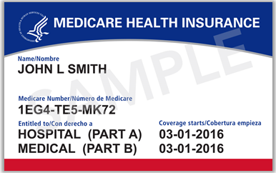
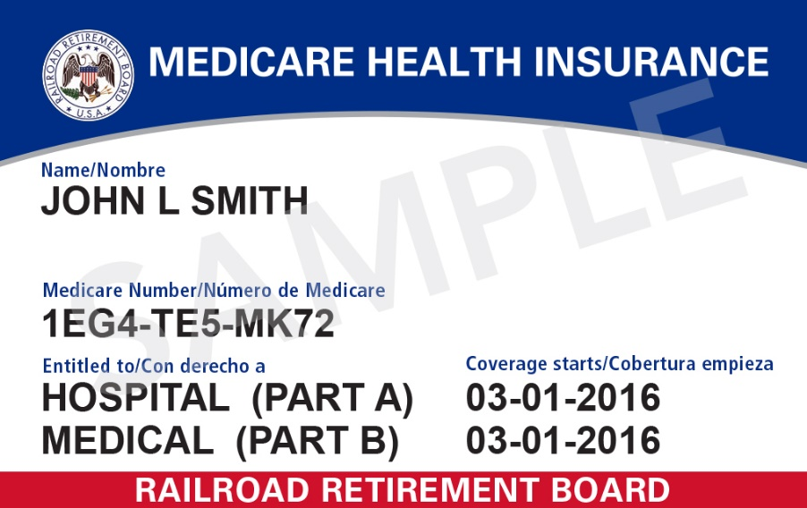
New Medicare Cards
New CMS Medicare Card
New Railroad Retirement Board Card

Slide 23
New Card Issuance
CMS will begin mailing new cards in April 2018 and will meet the congressional deadline for replacing all Medicare cards by April 2019
The gender and signature line will be removed from the new Medicare cards
The Railroad Retirement Board will issue their new cards to RRB
beneficiaries
We will work with states that currently include the HICN on Medicaid cards
to remove the Medicare ID or replace it with an MBI

Slide 24
Beneficiary Outreach and Education
CMS will conduct intensive education and outreach to all Medicare beneficiaries, their families, caregivers, and advocates to help prepare for this change from September 2017 through April 2019
Information about the new card is included in the 2018 Medicare & You Handbook that was mailed to all beneficiaries in September 2017
Once they receive their new cards, beneficiaries will be instructed to safely and securely destroy their old Medicare cards and keep the new Medicare number confidential
CMS is also working to develop a secure way for beneficiaries to be able to access their new Medicare number when needed

Slide 25
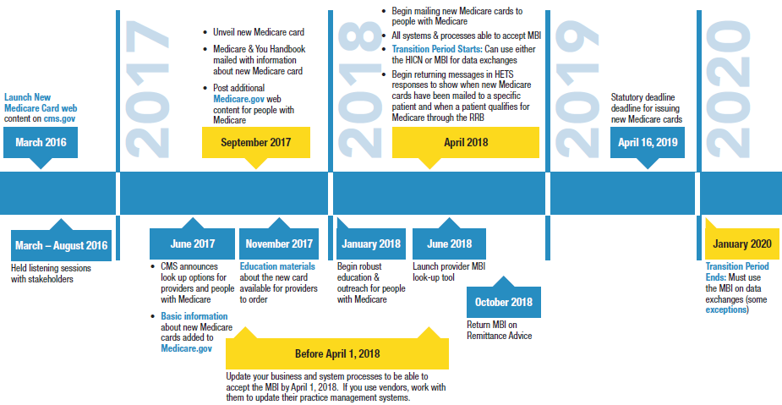
Timeline for Outreach

Slide 26
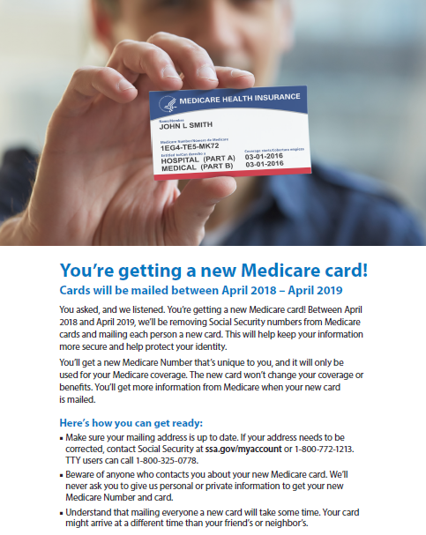
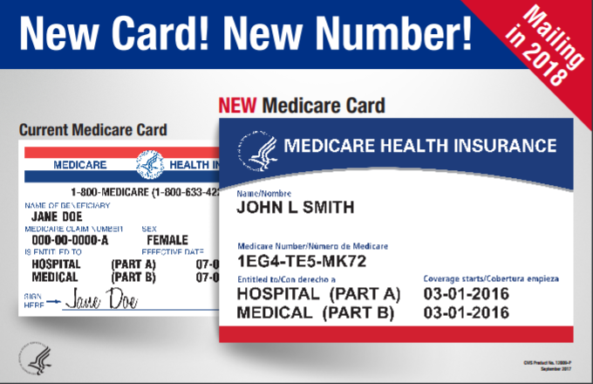
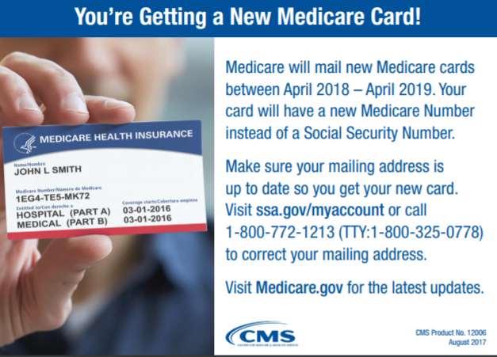
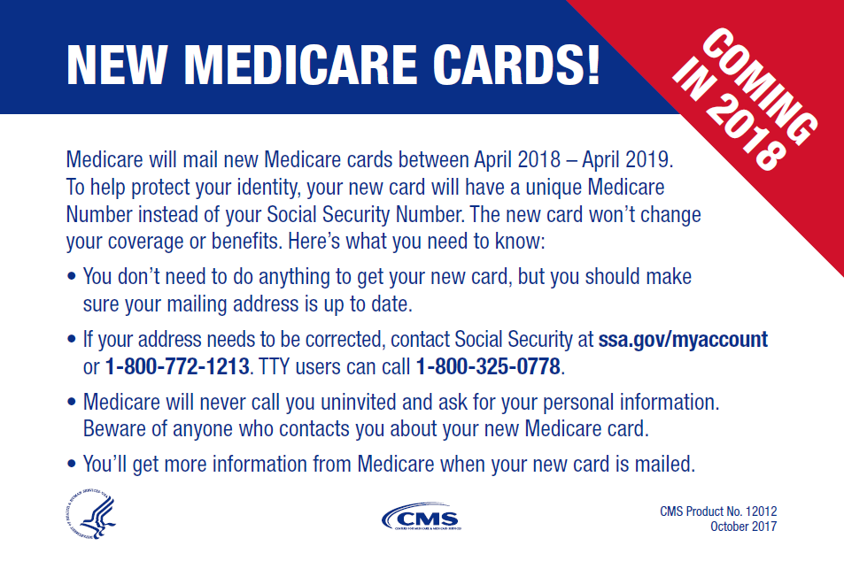
Outreach and Education Resources
Resources to help you communicate with people with Medicare are available on our website https://www.cms.gov/newcard to print and order
A flyer you can hand out
A Poster for Providers’ Offices
Tear-offs for Patients
Conference Cards for Beneficiaries

Slide 27
Key Points to Reinforce with Patients
Understand that mailing everyone a new card will take some time. Your card might arrive at a different time than your friend’s or neighbor’s.
Make sure your mailing address is up-to-date. If your address needs to be corrected, contact Social Security at ssa.gov/myaccount or 1-800-772-1213. TTY: 1-800-325-0778.
Beware of anyone who contacts you about your new Medicare card. We will never ask you to give us personal or private information to get your new Medicare number and card.

Slide 28
Key Points to Know
Providers (including pharmacies) need to be ready by April 1, 2018 (systems and business processes)
There will be a 21- month transition period from April 1, 2018 – December 31, 2019
Providers (including pharmacies) will have 3 ways to get the new MBI:
  Patient presents the card at time of service
  Provider receives it through the remittance advice
  Provider obtains it through the a secure web portal with the MAC
Providers (including pharmacies) have resources you can use when you talk to people with Medicare about the new Medicare cards: https://www.cms.gov/Medicare/New-Medicare-Card/Partners-and-Employers/Partners-and-employers.html

Slide 29
Final Thoughts
Thank you for participating in this discussion today, to learn more about the New Medicare Card you can:
  Participate in our Open Door Forums. We will let you know when calls are scheduled in MLN Connects (Providers)
  Check our New Medicare Card website for other information: https://www.cms.gov/newcard
Here are resources you can use when you talk to people with Medicare about the new Medicare cards: https://www.cms.gov/Medicare/New-Medicare-Card/Partners-and-Employers/Partners-and-employers.html
Please submit any additional comments or questions to the New Medicare Card team mailbox: NewMedicareCardSSNRemoval@cms.hhs.gov

