Slide 1
File Size Reduction Recommendations

Slide 2
Various Opportunities
Examples/Scenarios To Cover
Provider Grouping
Service Code
Multiple Plans Per File
Referenced Provider Groups
File Compression
Depending on your situation, your mileage may vary

Slide 3
Provider Groups

Slide 4
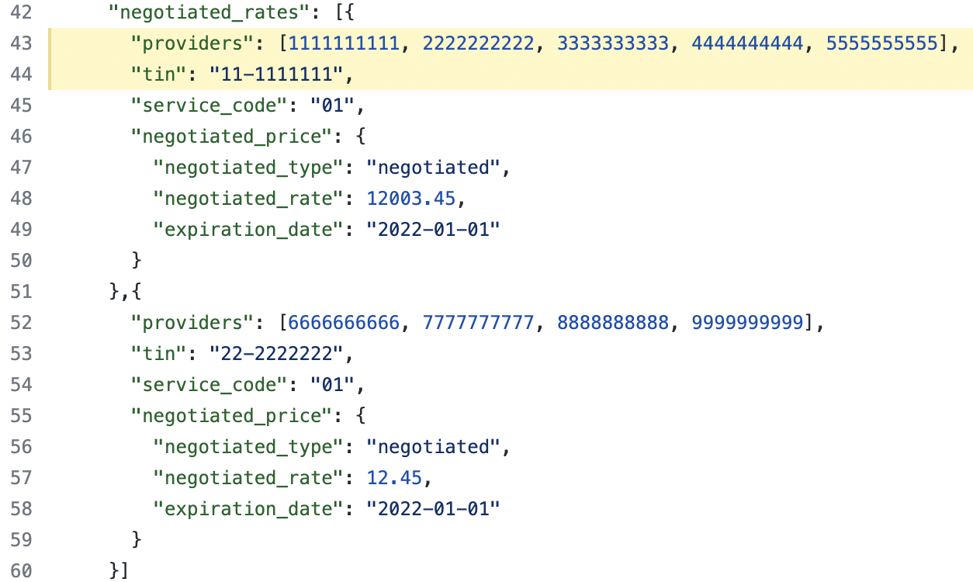
Provider Groups
Use-Case:
Providers that have negotiated rates for items and services under a single TIN.
SQL Pseudocode:
SELECT providers … GROUP BY tax-id
Previous Implementation:
Each group of providers by tin had its own negotiated price object

Slide 5
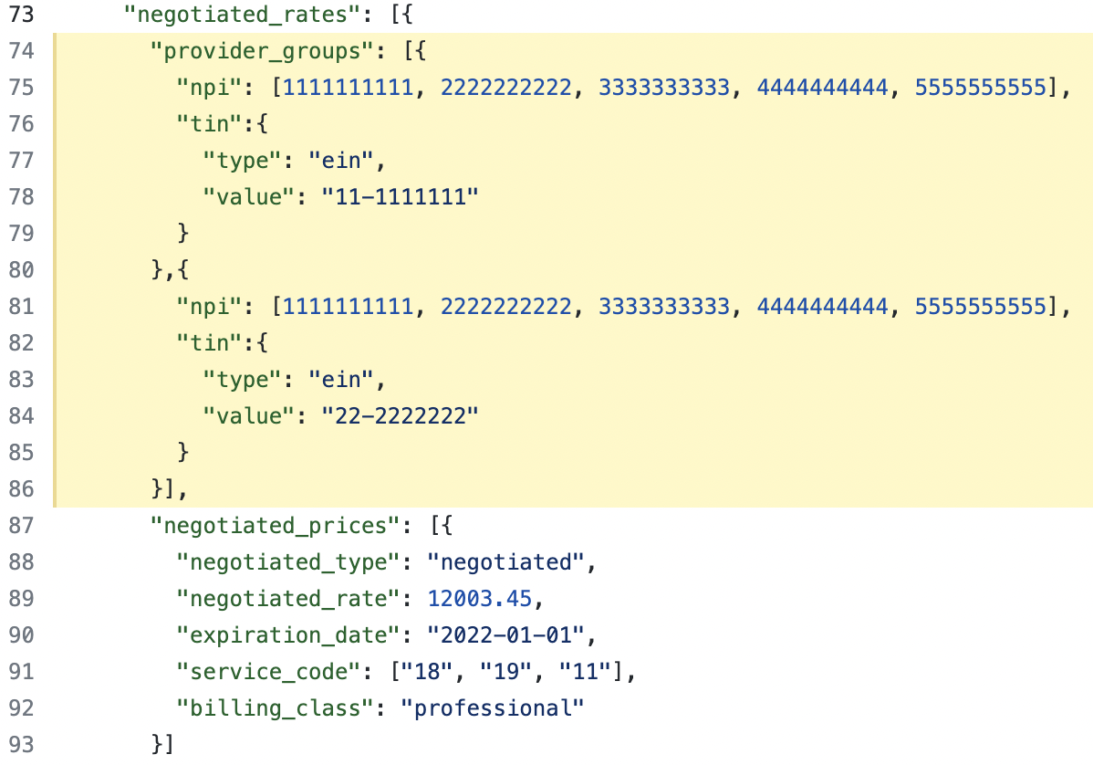
Provider Groups
Previous Implementation:
Each group of providers by tin had its own negotiated price object
Current Implementation:
Multiple provider/tin combinations can be associated to negotiated price objects.

Slide 6
Provider Groups
What you might be doing
"provider_groups": [{
"npi": [111, 222, 333],
"tin":{
"type": "ein",
"value": "11-1111111"
}
},{
"npi": [444, 555, 666],
"tin":{
"type": "ein",
"value": "11-1111111"
}
}]
What you can do instead
"provider_groups": [{
"npi": [111, 222, 333, 444, 555, 666],
"tin":{
"type": "ein",
"value": "11-1111111"
}
}]
Take Away: Group all the providers associated with a single TIN into a single provider group object

Slide 7
Service Code

Slide 8
Service Code
"negotiated_rates": [{
"providers": [111, 222, 333],
"tin": "11-1111111",
"service_code": "01",
"negotiated_price": {
"negotiated_type": "negotiated",
"negotiated_rate": 12.45,
"expiration_date": "2022-01-01"
}
},{
"providers": [111, 222, 333],
"tin": "11-1111111",
"service_code": "02",
"negotiated_price": {
"negotiated_type": "negotiated",
"negotiated_rate": 12.45,
"expiration_date": "2022-01-01"
}
}]
Use-Case:
Negotiated rates that are service code dependent.
Previous Implementation:
Each service code required a separate negotiated price object even if that negotiated price object was the same.

Slide 9
Service Code
Previous Implementation:
"negotiated_rates": [{
"providers": [111, 222, 333],
"tin": "11-1111111",
"service_code": "01",
"negotiated_price": {
"negotiated_type": "negotiated",
"negotiated_rate": 12.45,
"expiration_date": "2022-01-01"
}
}]
Current Implementation:
"negotiated_prices": [{
"negotiated_type": "negotiated",
"negotiated_rate": 123.45,
"expiration_date": "2022-01-01",
"service_code": ["18", "19", "11"],
"billing_class": "professional"
}]
Take Away: Group all relevant service codes together for the specific negotiated price

Slide 10
Multiple Plans Per File

Slide 11
Multiple Plans Per File
Use-Case:
Grouping plans together in a single file that have the same exact negotiated rates for all items and services for the same provider networks.
Impact:
Avoiding the possibility of producing hundreds of large duplicate files.

Slide 12
Multiple Plans Per File
Table Of Contents
"reporting_plans": [{
"plan_name": "medicaid",
"plan_id_type": "hios",
"plan_id": "11111111111",
"plan_market_type": "individual"
},{
"plan_name": "medicare",
"plan_id_type": "hios",
"plan_id": "0000000000",
"plan_market_type": "individual"
}],
"in_network_file": {
"description": "in-network file",
"location": "https://www.some_site.com/files/inn-123456.json"
},
"allowed_amount_file": {
"description": "allowed amount file",
"location": "https://www.some_site.com/files/aa-987665.json"
}
https://www.some_site.com/files/inn-123456.json
{
"reporting_entity_name": "cms",
"reporting_entity_type": "cms",
"last_updated_on": "2020-08-27",
"version": "1.0.0",
"in_network": [{...}]
}

Slide 13
Multiple Plans Per File
Take Away: If there are multiple plans that have the exact same negotiated rates for each item and service for each provider network, create a table of contents file that combines the plans and references the in-network or allowed-amount file.
This will absolutely decrease the total footprint size of the amount of files that are needed along with the storage needed.

Slide 14
Referenced Provider Groups

Slide 15
Referenced Provider Groups
Use-Case:
Large provider groups per TIN.
Many different provider groups.
Flat File Tweaks:
Flat files are typically denormalized views of data.
Normalized representations of data are typically found in a database or through (REST) API calls.

Slide 16
Referenced Provider Groups
Current Provider Group Implementation (taken from previous slide):
"negotiated_rates": [{
"provider_groups": [{
"npi": [111, 222, 333, 444, 555, 666],
"tin":{
"type": "ein",
"value": "11-1111111"
}
},{
"npi": [999, 888, 777],
"tin":{
"type": "ein",
"value": "22-2222222"
}
}],
"negotiated_prices": [{...}]
}
"provider_references":[{
"provider_group_id": 1,
"provider_group": {
"npi": [111, 222, 333, 444, 555, 666],
"tin":{
"type": "ein",
"value": "11-1111111"
}
}
},{
"provider_group_id": 2,
"provider_group": {
"npi": [999, 888, 777],
"tin": {
"type": "ein",
"value": "22-2222222"
}
}
}]

Slide 17
Referenced Provider Groups
"negotiated_rates": [{
"provider_groups": [{
"npi": [111, 222, 333, 444, 555, 666],
"tin":{
"type": "ein",
"value": "11-1111111"
}
},{
"npi": [999, 888, 777],
"tin":{
"type": "ein",
"value": "22-2222222"
}
}],
"negotiated_prices": [{
"negotiated_type": "negotiated",
"negotiated_rate": 12003.45,
"expiration_date": "2022-01-01",
"service_code": ["18", "19", "11"],
"billing_class": "professional"
}]
}
"provider_references":[{
"provider_group_id": 1,
"provider_group": {
"npi": [111, 222, 333, 444, 555, 666],
"tin":{
"type": "ein",
"value": "11-1111111"
}
}
},{
"provider_group_id": 2,
"provider_group": {
"npi": [999, 888, 777],
"tin": {
"type": "ein",
"value": "22-2222222"
}
}
}]
"negotiated_rates": [{
"provider_references": [1, 2],
"negotiated_prices": [{
"negotiated_type": "negotiated",
"negotiated_rate": 12003.45,
"expiration_date": "2022-01-01",
"service_code": ["18", "19", "11"],
"billing_class": "professional"
}]
}
Github Implementation Example

Slide 18
Referenced Provider Groups
Take Away: Normalize provider groups by defining them on the root object and reference them in the in-network file. Has the potential to reduce file size significantly.
Something to pay attention to: If external files are implemented, the normalized provider group schema format would be the same.

Slide 19
File Compression

Slide 20
File Compression
Use-Case:
Large uncompressed text files.
Common compression formats:
.7z, .zip, .tar.gz, .rar, etc
Take Away: Text files such as the machine-readable files will benefit greatly from being compressed. This will not only help with storage considerations but also with network bandwidth.

