Slide 1


CMS IT Governance Training
Governance Review Team &
How it Can Help
Click the Slide Show image in bottom right bar to begin presentation.

Slide 2
What is the Governance Review Team (GRT)?
  Planning forum of Subject Matter Experts who help teams think through their options and develop well-informed business and technical solutions that satisfy CMS’ enterprise standards and strategy.
  Primary resource for project teams to help them navigate various aspects of their IT projects and provide recommendations to support successful implementation.
  Providing recommendations early on can identify potential trouble spots in the project that could cause cost and schedule overruns.

Slide 3
Subject Matter Expertise
Broad knowledge of technical, operational, and governance responsibilities:
Governance Review Team
Acquisitions
Investment Management
Shared Services
CMS Data
Security & Privacy
Accessibility
Hosting & Infrastructure
Financial Management
Records Management
Technical Review Board
IT Contracting Process
IT Budgeting Process
Investment Management (CPIC Requirements)
Existing solutions which may meet your business needs
Adopting CMS' Shared IT Services and Tools
Technical guidance to integrate IT systems
Key IT solutions/Hosting/Infrastructure
Availability and Use of CMS Enterprise Data
Interfacing with Medicare IT Systems
Information Security
Information Privacy
Section 508 and 504 Compliance
Helping Project Teams Navigate OIT

Slide 4
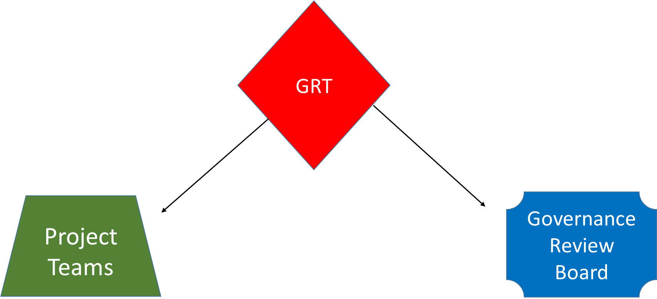
Dual Advisory Role
How to proceed through the IT Governance process
What resources are available to help
How to adhere to required Governance oversight
How to properly develop and document their Business Case and Alternatives Analysis
Conducts preliminary review of Business Case and recommends the preferred solution
Performs due diligence on behalf of GRB
  Includes all potential alternatives
  Cost benefit analysis with Pros & Cons
  Technical, contractual, and fiscal feasibility of each
  Potential issues, risks, and pitfalls

Slide 5
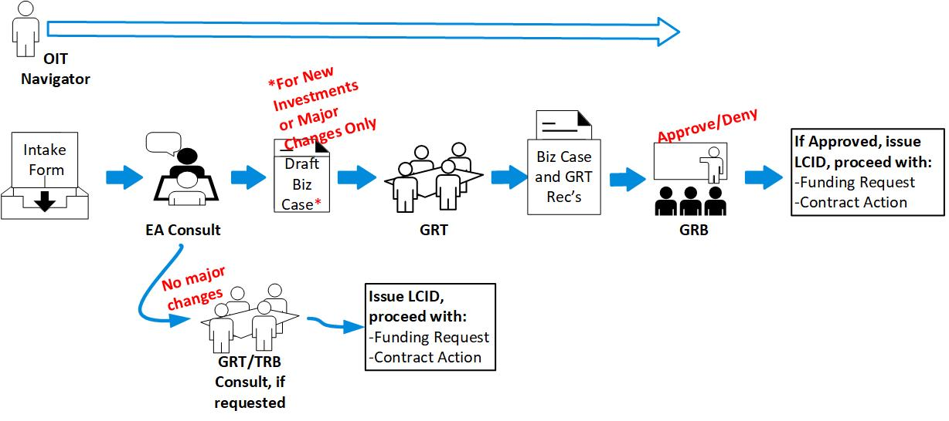
Target Life Cycle Initiate Phase

Slide 6
Business Case Support
Guides the Business Owner in developing a meaningful Business Case that includes a cost benefit analysis with pros and cons of each alternative
Ensures the business considers:
    COTS, open source, and emerging technologies
    leveraging existing assets and solutions to avoid duplication of another effort.

Slide 7
GRT – Recommendations
GRT SMEs serve as internal CMS consultants.
Include any GRT recommendations in the Alternatives Analysis.
Business owners may offer different alternatives, but must make the case why their alternative is superior.

Slide 8
Contact
For questions about IT Governance or more information email:
IT_Governance@cms.hhs.gov
or visit:
IT Governance (https://www.cms.gov/TLC)

