Slide 1

CMS IT Governance Training
Cost Estimation

Slide 2
What is Estimation?
Cost estimation is the process of estimating all of the costs associated with completing a project within scope and according to its timeline.
Typically, project managers will use high-level estimates in the earliest stages of project planning to determine whether or not a project is ultimately pursued.

Slide 3
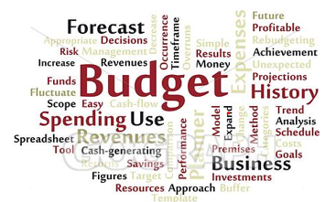
  Why is Cost Estimation Important?
Reliable estimating is crucial for making informed IT decisions. We use them to:
        Develop annual budget requests
        Evaluate resource requirements at key decision points
        Understand how today's decisions impact tomorrow's budget
        Establish spending baselines
        Plan for total life cycle costs

Slide 4
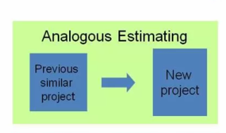
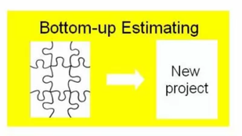
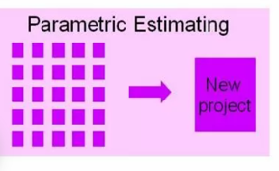
Conventional Cost Estimation Techniques
Analogous / Top-Down Estimating: PM calculates cost based on the known costs associated with a similar project previously completed.
Bottom-Up Estimating PM tallies costs for every expense starting at the bottom and accounting for each expected cost.
Parametric Estimating: PM uses a statistical approach to determine the expected financial resources or time required to complete a project or activity.
Three Point Estimating: PM determines a weighted average of 3 data points: optimistic (best case), pessimistic (worst case), and most likely cost.
Three Point Estimating
1
2
3

Slide 5
Comparing Techniques
 | Analogous | Bottom-Up | Parametric | Three Point
Strengths | Detailed project information not needed. No data manipulation or detailed cost analysis. Quick and cost-efficient. | Highly accurate means of estimating total cost. Gives good insight into major cost contributors. | Allows you to measure error from a derived Cost estimation relationship. Model can be reused for similar projects. Quickly accommodate changes in design. | Improves overall accuracy by taking the average. Takes Risk into account by applying weights.
Weaknesses | No two projects are exactly the same. Ignores the technical details of a project yielding inaccurate results. Often difficult to find the detailed cost, technical, and program data required. | Can be expensive and time consuming to produce. Not flexible. Alternatives must be built bottom-up. Requirements must be well known and stable. | Requires initial data to be normalized which is time-consuming. May be difficult for others to readily understand the cost-independent variable relationship. | The absoluteness of the end points.

Slide 6
Cost Estimation for Agile Projects
Parametric and bottom-up techniques can provide estimates for Agile teams for fixed costs.
Top-down estimating techniques, such as analogous should be used for developmental work, which does not have a fixed scope.
Iteratively update and refine cost estimates as actual data becomes available.

Slide 7
Sources for Pricing Data
The Acquisition Gateway built by GSA includes a number of resources, data, and tools, including an Independent Government Cost Estimate (IGCE) Tool and a Governmentwide Acquisition Contracts Prices Paid tool.
Additional data sources may include:
  Benchmarking Data
  Responses to Requests for Information
  Proofs of concept
  Cost Reports
  Experienced developers, engineers and other SMEs
  Other federal agencies

Slide 8
Contact Us
For assistance with Cost Estimation, contact the Investment Management Team at IT_Investments@cms.hhs.gov.
For assistance with the Target Life Cycle, contact the IT Governance Team at IT_Governance@cms.hhs.gov or visit our website at www.cms.gov/TLC.

