Slide 1
The Future of
Quality Measurement:
2020 and Beyond
Notes:
Maria/Michelle

Slide 2
Agenda
CMS Quality Measurement
      Our Current State
      Where are we going?
Merit-Based Incentive Payment System (MIPS) Value Pathways (MVPs)
Patient Reported Outcome-Based Performance Measures in Quality Measurement
Development of PRO Measures in End Stage Renal Disease (ESRD): A Special Use Case
DISCUSSION
Notes:
Maria/Michelle

Slide 3
Learning Objectives
By the end of the presentation participants should be able to:
    name quality measurement priorities for CMS moving forward;
    summarize proposed changes to MIPS;
    define PRO, PROM, and PRO-PM; and
    recall new tools and methods supporting the development of PROs/PROMs/PRO-PMs.
Notes:
Maria/Michelle

Slide 4
How to Obtain CEU for this session
In order to receive continuing education credits (CEU) for a conference session, you must pass the post-assessment and complete the evaluation. The continuing education post-assessments and evaluations are being administered through the Medicare Learning Network®.
Visit the 2020 CMS Quality Conference, Master Classes webpage for further guidance. Full instructions will be posted Thursday, February 27, 2020.
Please make sure to sign-in if you will be seeking CEUs!
Notes:
Maria/Michelle

Slide 5
CMS Quality Measurement:
Our Current State
Notes:
Maria/Michelle

Slide 6
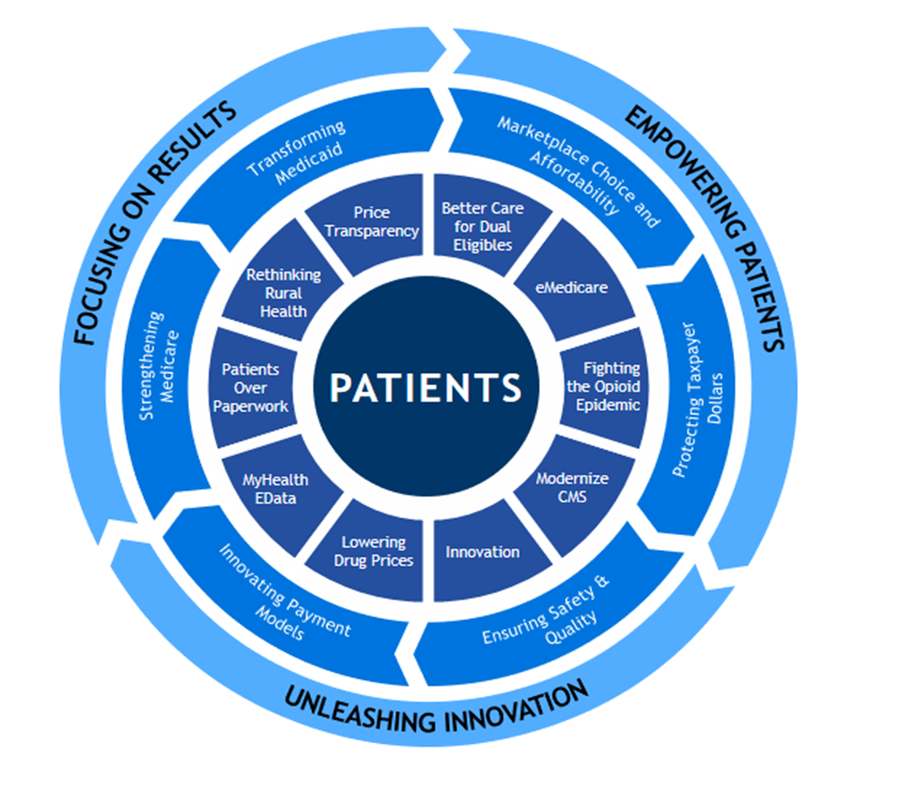
CMS Strategic Priorities
CMS Objective: Improve the nation’s health and quality of life.
Enterprise Key Result #1: Improve the quality and affordability of health care for all Americans.
Enterprise Key Result #2: Drive American health care towards payment for value, not volume.
Enterprise Key Result #3: Lower America’s rate of growth in healthcare spending.
6
Notes:
Maria/Michelle

Slide 7

Patients Over Paperwork
CMS’s Primary Goal: Remove obstacles that get in the way of the time clinicians spend with their patients
Patients Over Paperwork
  Shows CMS’s commitment to patient-centered care and improving beneficiary outcomes
  Includes several major tasks aimed at reducing burden for clinicians
  Motivates CMS to evaluate its regulations to see what could be improved
7
Notes:
Maria/Michelle

Slide 8

A New Approach to Meaningful Outcomes
What is the Meaningful Measures Initiative?
Launched in 2017, the purpose of the Meaningful Measures initiative is to:
  Improve outcomes for patients
  Reduce data reporting burden and costs on clinicians and other health care providers
  Focus CMS’s quality measurement and improvement efforts to better align with what is most meaningful to patients
8
Notes:
Maria/Michelle

Slide 9
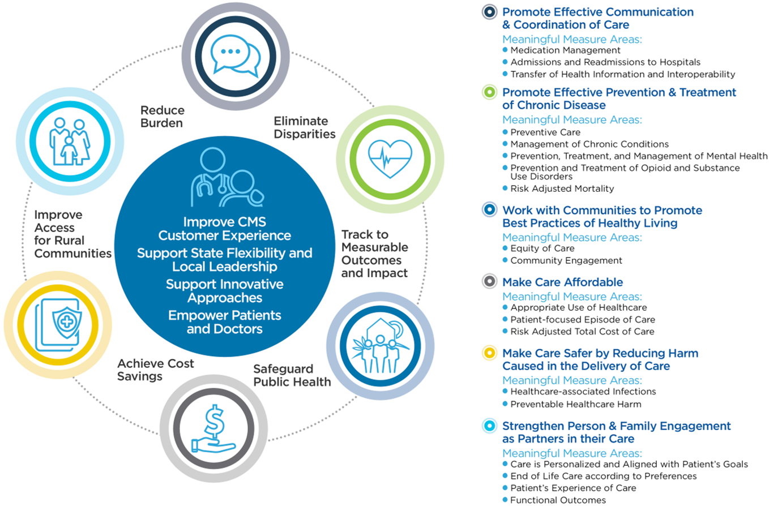
Meaningful Measures Framework 1.0
9
Notes:
Maria/Michelle

Slide 10
Measure Reduction through Meaningful Measures
Thus far, Meaningful Measures has supported measure efforts in CMS programs by:
  Eliminating redundant, not clinically relevant, low impact measures from our programs.
  To date, removing 15% of overall measures from programs with a IQR 60% reduction and MIPS 22% reduction.
  Identifying gap areas across programs.
  Prioritizing outcome (including patient reported) over process measures.
Notes:
Maria/Michelle

Slide 11
Measure Reduction Trends (2020-2022)
11
Notes:
Maria/Michelle

Slide 12
Changes in Measures
12
Notes:
Maria/Michelle

Slide 13
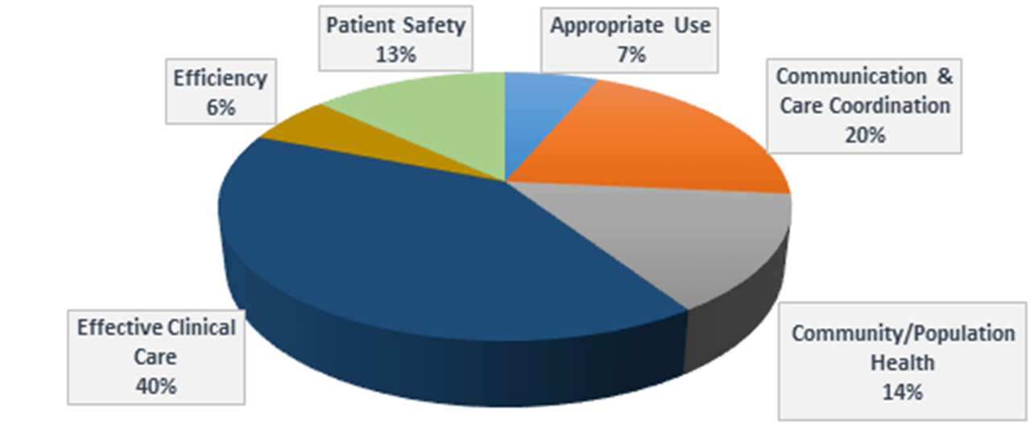
Process Measure Breakout Distribution for ALL Programs (2020)
13
Notes:
Maria/Michelle

Slide 14
CMS Quality Measurement
Where are we going?
Notes:
Maria/Michelle

Slide 15
Stakeholder Feedback
Meaningful Measures needs to be:
  Patient-centered,
  Inclusive of all care settings,
  Representative of patients across all CMS programs,
  and most of all…
SIMPLIFIED.
Notes:
Maria/Michelle

Slide 16
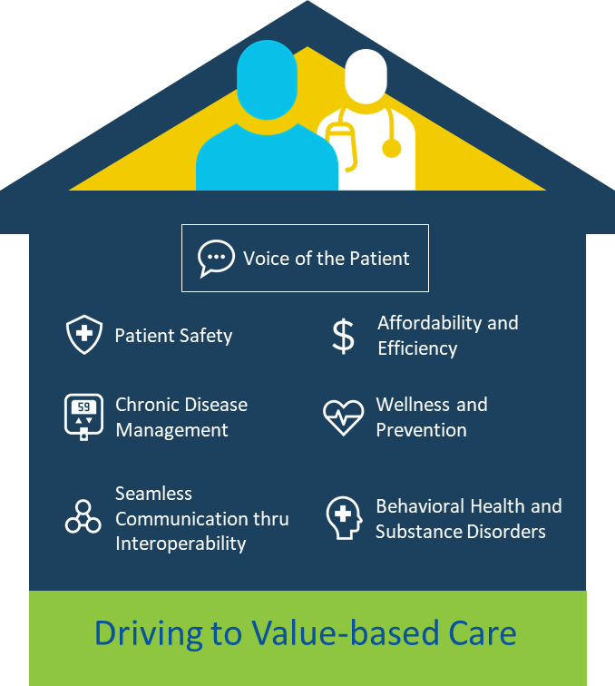
Meaningful Measures Framework 2.0 (draft)
Notes:
Maria/Michelle
First, we should talk about meaningful measures (at a high level), couching it in terms of how CMS views measures as part of a bigger strategy toward healthcare quality improvement.

Slide 17
Key Themes
Rapid performance feedback to providers
Accelerate move to fully electronic measures
Unleash voice of patient through use of patient reported outcome measures
Use measures that will advance innovative payment structures
Increase alignment of measures
Promote use of all payer data (where feasible)
Focus on major domain outcomes
Notes:
Maria/Michelle

Slide 18

Digital Measurement Strategy
Developing more APIs for quality measure data submission
Prototype the use of the FHIR standard for quality measurement
Interoperable electronic registries – incentivizing use
Harmonizing measures across registries
Timely and actionable feedback to providers
Working across CMS on the use of artificial intelligence to predict outcomes
18
Notes:
Maria/Michelle

Slide 19
Unleash Voice of the Patient
Provide much more patient perspective on what is important, and health performance (“customer obsessed”) with goal of significant patient outcome information into all programs
Current Patient-Reported Outcome Measures are somewhat difficult to use, not integrated into EMR workflow, require hiring additional staff to call/track down patients
Develop PRO measures which are embedded in workflow, may be accessed through API or patient portal which will allow for ease of use and reduce burden for reporting
Seeking to prioritize use of NIH developed PROMIS tools (avoids licensing fees; nationally recognized)
Working across CMS to use “Self-Reported Health” as an agency-wide key result that reflects the patient’s voice around quality of care
19
Notes:
Maria/Michelle

Slide 20
Measures Focused on Key Domains
National Serious Safety Event Rate
Healthcare Associated Infections
CLABSI
CAUTI
Healthcare Unintended Complications
High Reliability/Error Reduction
EMR Safety
MRSA
CDI
SSI
Hand Hygiene
Line Insertion Protocol Compliance
Maintenance Protocol Compliance
Femoral Line Use
Catheter Days
Patient Safety
Component
Focus on Key Domains or
Key Indicators as National Measures
Move away from Component or
Element Measures
Left shift of reported measures would decrease number of measures in program and Reduce burden
Key Indicator
Elements
Key Domain Measure
Domain
Notes:
Maria/Michelle

Slide 21

Meaningful Measures Next Steps
Modernize value based programs
Continue to refine priorities and focus on key measure gaps
Focus on domains of population health, patient reported outcomes and cost
Advance electronic infrastructure
Improve patients/consumer engagement through transparency and public reporting
GIVE US YOUR FEEDBACK!
MeaningfulMeasuresQA@cms.hhs.gov
21
Notes:
Maria/Michelle

Slide 22
MIPS Value Pathways (MVPs)
22
Notes:
Reena

Slide 23
Current Participation in MIPS
What we’ve been hearing from clinicians:
The current structure of MIPS and the reporting requirements are confusing
There is too much choice and complexity when it comes to selecting and reporting measures and activities
The measures and activities aren’t always relevant to a clinician’s specialty
It’s hard for patients to compare performance across clinicians
While there have been incremental changes to the program each year, additional long-term improvements are needed to align with CMS’ goal to develop a meaningful program for every clinician, regardless of practice size or specialty.
Notes:
Reena

Slide 24
MIPS Value Pathways (MVPs)
CMS is committed to the transformation of MIPS through the MIPS Value Pathways (MVPs), a new participation framework beginning in the 2021 performance year. This new framework will:
  Remove barriers to Alternative Payment Model (APM) participation
  Move away from siloed activities and towards an aligned set of measure options more relevant to a clinician’s scope of practice that is meaningful to patient care
  Promote value by focusing on Quality and Cost measures and Improvement Activities built on a foundation of population health measures calculated from administrative claims-based quality measures and Promoting Interoperability concepts
  Further reduce reporting burden
  Keep the patient at the center of our work
CMS is committed to working with stakeholders to develop this new framework, as well as develop additional ways to reduce burden in the MIPS program.
Notes:
Reena

Slide 25
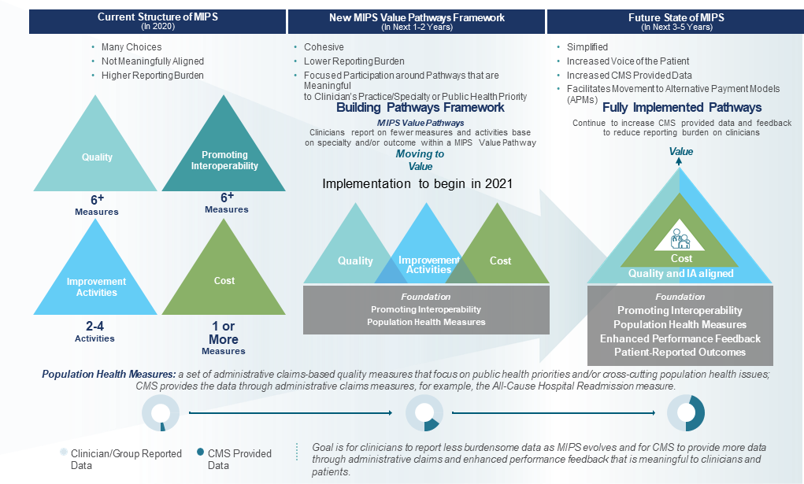
MVP Evolution
Notes:
Reena

Slide 26
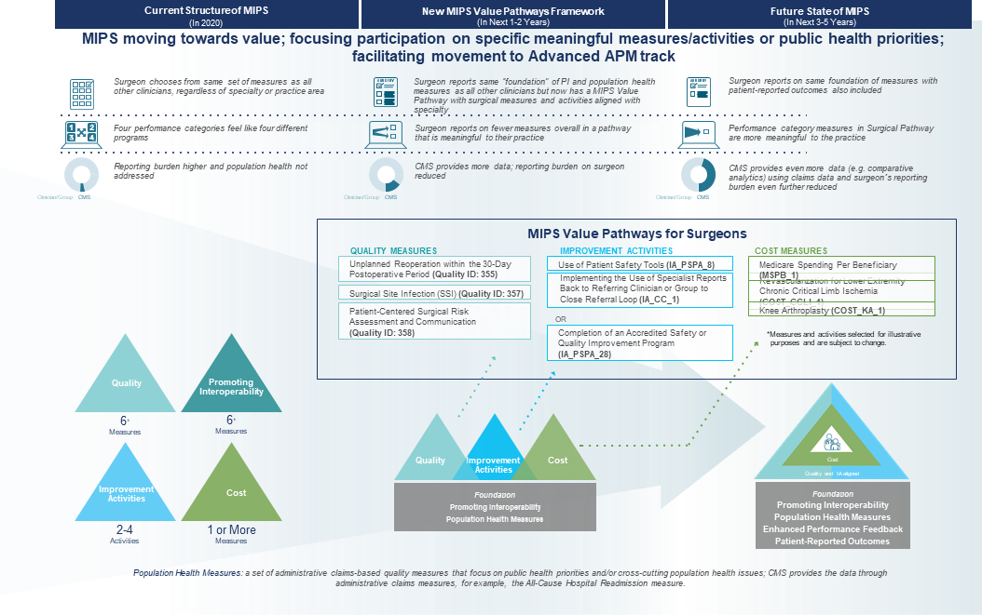
MVPs: Surgery

Slide 27
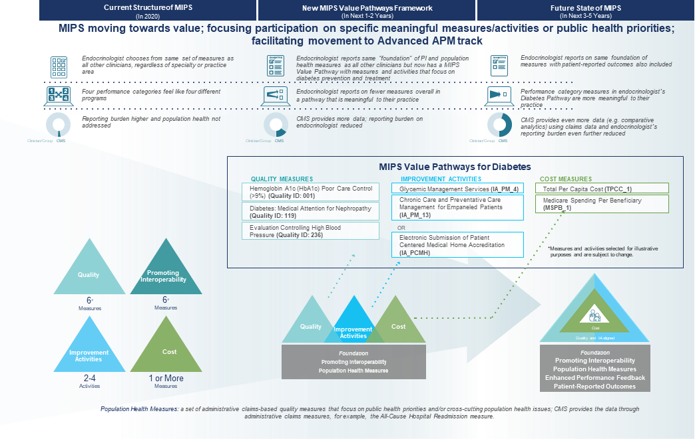
MVPs: Diabetes
Notes:
Reena

Slide 28
Merit-Based Incentive Payment System (MIPS)
28
Notes:
Reena

Slide 29
2020 Changes to MIPS Performance Categories
Quality: Increased the data completeness threshold to 70%; continued to remove low-bar, standard of care process measures; addressed benchmarking for certain measures to avoid potentially incentivizing inappropriate treatment; focused on high-priority outcome measures; and added new specialty sets
Cost: Added 10 new episode-based measures to continue expanding access to this performance category; revised the existing Medicare Spending Per Beneficiary Clinician (MSPB Clinician) and Total Per Capita Cost (TPCC) measures
Improvement Activities: Increased the participation threshold for group reporting from a single clinician to 50% of the clinicians in the practice; updated the Improvement Activity Inventory and established criteria for removal in the future; and concluded the CMS Study on Factors Associated with Reporting Quality Measures
Promoting Interoperability: Kept the Query of Prescription Drug Monitoring Program measure as an optional measure; removed the Verify Opioid Treatment Agreement measure; and reduced the threshold for a group to be considered hospital-based
Notes:
Reena

Slide 30
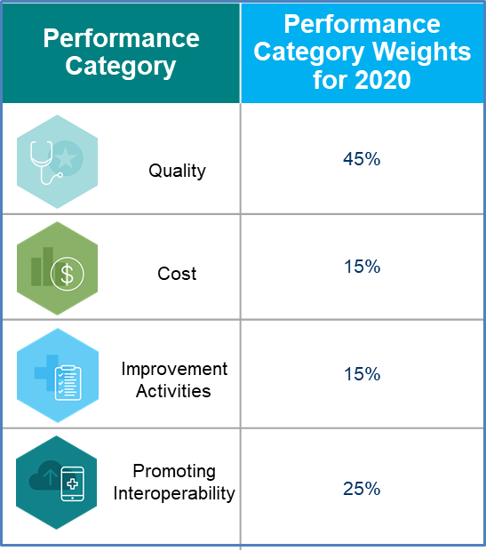
MIPS Policies for the 2020 Performance Period: Performance Category Weights
30
Notes:
Reena

Slide 31
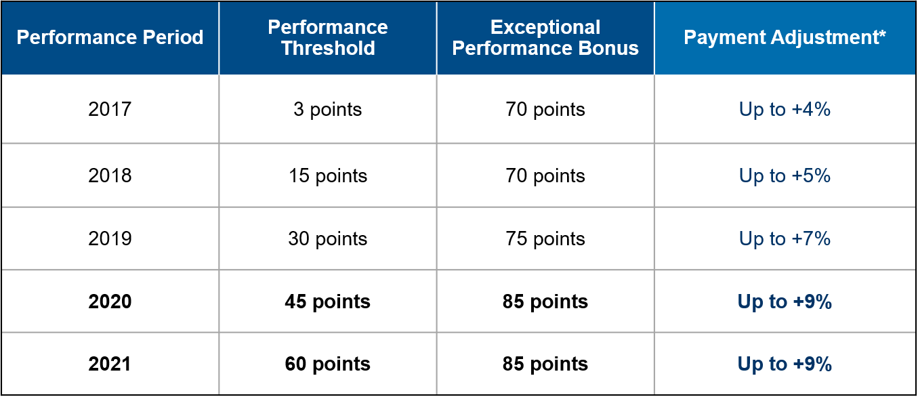
MIPS Policies for the 2020 Performance Period: Payment Adjustments
*Payment adjustment (and exceptional performer bonus) is based on comparing final score to performance threshold and additional performance threshold for exceptional performance. To ensure budget neutrality, positive MIPS payment adjustment factors are likely to be increased or decreased by an amount called a “scaling factor.” The amount of the scaling factor depends on the distribution of final scores across all MIPS eligible clinicians.
Notes:
Reena

Slide 32
MIPS Policies for the 2020 Performance Period, cont.
Third-Party Intermediaries:
CMS is focused on improving partnerships with third parties to help reduce clinician reporting burden.
Beginning with the 2020 performance period, Qualified Clinical Data Registries (QCDRs) are required to work together to harmonize similar measures.
Beginning with the 2021 performance period, third-party intermediaries are required to consolidate services by:
  Providing continuity of service to their participants
  Supporting all MIPS performance categories that require data submission
  Providing enhanced performance feedback and allowing clinicians to view their performance on a given measure in comparison to others
  Requiring that QCDR measures be fully developed and tested prior to self-nomination
Additional Changes:
Final score reweighting policy finalized to address data integrity concerns
Targeted review requests must be submitted within 60 days of the release of the MIPS payment adjustment factor(s) with performance feedback
Notes:
Reena

Slide 33
Patient Reported Outcome-Based Performance Measures in Quality Measurement
33
Notes:
Lisa
I will introduce myself and my experience with PRO-PMs on this slide:
Internist and rheumatologist
Measure developer (17 outcome measures, 2 PRO-PMs)
Since 2015, overseen voluntary PRO and risk variable data collection and submission as part of CMMI’s Comprehensive Care for Joint Replacement (CJR) bundled payment model
Over 450 IPPS hospitals in 67 different MSAs
Nearly half submitted PRO and risk variable data
Data used to develop risk-adjusted hospital-level PRO-PM

Slide 34
Overview of Patient-Reported Outcomes
Patient-reported outcomes (PROs) represent critical information for shared decision making and determining healthcare value
“PROMs” are the surveys used to collect PROs
  Can be global/generic or specific to a disease or health problem
“PRO-PMs” are the performance measures that use PRO data to assess care quality
Together they allow us to unleash the patient voice.
34
Notes:
Lisa

Slide 35
HOOS, JR
Hip dysfunction and Osteoarthritis Outcome Score for Joint Replacement
Example of short-form procedure-specific PROM
6 questions about pain and functional status for patient undergoing hip replacement
Allows assessment of baseline (pre-op) and follow-up symptoms and function for hip replacement patients
Captures items most impacted by hip replacement surgery
Notes:
Lisa

Slide 36
PROMIS Global Health
One of the PROMIS® (Patient-Reported Outcomes Measurement Information System) set of person-centered measures that evaluates and monitors physical, mental, and social health in adults & children
10 questions that produce distinct Physical and Mental Health scores
Designed to be relevant across all conditions
Available in multiple formats, including computer adaptive versions
Less responsive to some treatments
PROsetta Stone® allows comparison of different PROM scores
Notes:
Lisa

Slide 37
Challenges and Successes of PRO-PMs
PRO data are not routinely captured
When collected, often use different instruments, don’t leverage technology and yield low response rates due to high burden and vague benefits
Highest response rates are seen when patients and providers access PRO data at the point-of-care and use it for clinical decision making
Organizations embracing PROs find improved outcomes, provider-patient relationships and even provider quality of life
PROMIS and PROsetta Stone offer potential tools for expanding adoption of PROs, leading to more rapid PRO-PM development
Notes:
Lisa

Slide 38
Development of PRO Measures in End Stage Renal Disease (ESRD)
A Special Use Case
Notes:
Claudia

Slide 39
Development of PRO Measure for ESRD Dialysis Patients
ESRD patients and dialysis providers are a distinct community
  Payment policy and entitlement for ESRD benefits
  High frequency of patient-provider treatment encounters
  Disease/Treatment burden impact quality of life
Developing a 4 item patient reported survey to assess life goals
  Asks ESRD patients on chronic dialysis about their life goals, whether their care team talks to them about life goals and supports those goals
    Being able to go to work / school
    Spend time with family
    Not feel like a “person on dialysis”
    Have independence
Notes:
Claudia
Bullet 3.3: For example, treatment options vary widely and have different impact on function and quality of life.

Slide 40
Development of PRO Measure for ESRD Dialysis Patients, cont.
The intent is for the PRO measure to serve as a tool that supports patient and care team discussions that can result in tailoring dialysis treatment and modality choices to best support patient life goals
Draft survey went through cognitive interview testing in fall 2019 with 13 patients and 10 dialysis providers
  Received over 60 patient volunteers for the cognitive interviews
Field testing the survey in 2020 in 500-600 patients nationally
Notes:
Claudia

Slide 41
Leveraging the Patient Voice in PRO Measure Development
Key Takeaway: Engage patients early in measure development to capture what is important to them
Life goals PRO recommended for development by a Technical Expert Panel held in 2017 that included 9 ESRD patients and 9 dialysis providers
  “Putting dialysis treatment in service to supporting patient life goals, where treatment must be in service to what patients want”
Patients can identify specific considerations
Value of patient engagement for establishing PRO measure importance and measure validity
Notes:
Claudia
Sub-bullet 1: (Quote from a PRO TEP member). For example, due to consuming nature of chronic dialysis treatment (time, physical fatigue, bothersome symptoms, dietary restrictions) patients and providers felt it was important there was a PRO tool that could support patient-provider discussions and shared decision making around treatment
Bullet 3: For example:
The need for shorter surveys
Knowing survey responses are used to improve patient care and support shared decision making
Whether individual patient self-report should be anonymous

Slide 42
Leveraging the Patient Voice in PRO Measure Development, cont.
Key Takeaway: Processes for engaging patients in PRO measure development
Establishing relationships with patient organizations
  Engaged the major national kidney patient organizations
  Their role was to disseminate information about measure development expert panels and encourage their members to participate on TEPs and other stages of measure development
Technical Expert Panels, focus groups, and cognitive testing
  50% patient representation
  Seek clinically and demographically diverse patient participants
Notes:
Claudia

Slide 43
Generic versus Disease Specific PROMs in ESRD
Key Takeaway: Disease specific PROMs are needed in certain cases
Generalizing case from development of the ESRD measure
  Characteristics of chronic condition, significant impact of disease and treatment on quality of life and pursuit of life goals. Treatment options vary widely (transplant, PD/home dialysis, in-center hemodialysis) and each can impact pursuit of life goals
  Early patient engagement can establish whether a generic PROM is appropriate. For example, would need to add ESRD specific items to PROMIS and validate in the dialysis population; some did not think it should be used in the dialysis population
Notes:
Claudia
Bullet 1.1: Examples: because PD is done at home by the patient, it may be a better option for those who want to work full time/return to work, or go to/continue school, travel. In-center may be preferred by patients that do not want the burden of doing their own treatment at home and to keep home life and activities separate from their dialysis treatment. Transplant considered best treatment option overall because better survival, patients no longer require dialysis, and very often can pursue goals and activities that were severely limited by chronic dialysis treatment.
Bullet 1.2: We asked PRO TEP to review PROMIS.

Slide 44
Summary
Some patient populations like ESRD may provide a special use-case for approaches to PRO measure development
Engaging patients early and throughout development is important for establishing importance of the PRO measure concept and measure validity, and future implementation
  ESRD patient and provider community is very active and supportive of engagement
Patient engagement can also identify potential issues to consider in development and implementation
  How PRO data are collected and incorporated into clinical workflow to support shared decision making
  Appropriateness of generic or disease specific PROM
  Minimizing survey burden
Notes:
Lisa
Bullet 3.1: For example, there may be high vulnerability in some patient populations and the accuracy of self report may be impacted by their trust in their provider. This may determine whether individual patient level data are directly available to provider or PRO data need to be aggregated and anonymized across patients.
Aggregate (anonymized) data may be more accurate but compromises provider’s ability to intervene and directly address individual patient issues; but direct patient level capture may be less accurate if patients feel vulnerable or lack trust in provider; can also undermine PRO data validity. Unclear if one method of data capture is more actionable than the other.
Engaging patients in development can help identify these issues. What we heard in ESRD is many patients do not trust their care team and fear retribution if their responses may be viewed as critical of their facility or care team.

Slide 45

DISCUSSION
45
Notes:
Michelle

Slide 46
GIVE US YOUR FEEDBACK!
MeaningfulMeasuresQA@cms.hhs.gov
46
Notes:
Michelle

