Slide 1
Quality Reporting Program Provider Training
LTCH QRP: Achieving a Full APU
Christy Hughes, M.H.A
Program Coordinator, LTCH QRP
Centers for Medicare & Medicaid Services
Teresa Mota, B.S.N., R.N.
Associate Scientist/Nurse Researcher
Abt Associates
May 27, 2021
    Please wait, the webinar will begin shortly.

Slide 2
Quality Reporting Program Provider Training
LTCH QRP: Achieving a Full APU
Christy Hughes, M.H.A
Program Coordinator, LTCH QRP
Centers for Medicare & Medicaid Services
Teresa Mota, B.S.N., R.N.
Associate Scientist/Nurse Researcher
Abt Associates
May 27, 2021

Slide 3
Disclaimer
This presentation was current at the time it was published or uploaded to the web. Medicare policy changes frequently, so links to the source documents have been provided within this document for your reference.
This presentation was prepared as a service to the public and is not intended to grant rights or impose obligations. This presentation may contain references or links to statutes, regulations, or other policy materials. The information provided is only intended to be a general summary. It is not intended to take the place of either the written law or regulations. We encourage readers to review the specific statutes, regulations, and other interpretive materials for a full and accurate statement of their contents.

Slide 4

Today’s Agenda
30
Welcome and Introductions.
What is the Long-Term Care Hospital (LTCH) Quality Reporting Program (QRP)?
LTCH Continuity Assessment Record and Evaluation (CARE) Data Set (LCDS) and Submission and Reporting Requirements.
Internet Quality Improvement and Evaluation System (iQIES).
Determining Compliance With the LTCH QRP.
Resources.
Q&A Session.
March
Notes:
Welcome and Introductions.
What is the Long-Term Care Hospital (LTCH) Quality Reporting Program (QRP)?
Continuity Assessment Record and Evaluation (CARE) Data Set and Submission and Reporting Requirements.
Internet Quality Improvement and Evaluation System (iQIES).
Determining Compliance with the LTCH QRP.
Resources.
Q&A Session.

Slide 5
Objectives
Recall the basics of the LTCH QRP.
Identify the LCDS submission requirements and data submission threshold.
Describe the steps related to LCDS data submission and acceptance.
Discuss the application of various iQIES reports.
Describe the impact of LTCH QRP data submission on the Annual Payment Update (APU).
Identify one resource for providers related to each of the topics presented.

Slide 6


Today’s Presenters
Christy Hughes, M.H.A
LTCH QRP Coordinator
Centers for Medicare & Medicaid Services
Teresa Mota, B.S.N., R.N.
Associate Scientist/Nurse Researcher
Abt Associates

Slide 7

Acronyms in This Presentation
APU – Annual Payment Update
ARD – Assessment Reference Date
CARE – Continuity Assessment Record and Evaluation
CAUTI – Catheter-Associated Urinary Tract Infection
CCN – CMS Certification Number
CDC – Centers for Disease Control and Prevention
CDI – Clostridium difficile Infection
CLABSI – Central Line-Associated Bloodstream Infection
CMS – Centers for Medicare & Medicaid Services

Slide 8

Acronyms in This Presentation (cont. 1)
CY – Calendar Year
FVR – Final Validation Report
FY – Fiscal Year
HAI – Healthcare-Associated Infections
IMPACT Act – Improving Medicare Post-Acute Care Transformation Act
iQIES – Internet Quality Improvement and Evaluation System
LCDS – LTCH CARE Data Set
LTCH – Long-Term Care Hospital
MAC – Medicare Administrative Contractor

Slide 9

Acronyms in This Presentation (cont. 2)
NHSN – National Healthcare Safety Network
PAC – Post-Acute Care
PHE – Public Health Emergency
PHI – Protected Health Information
PTR – Provider Threshold Report
QM – Quality Measure
QRP – Quality Reporting Program
QTSO – iQIES Technical Support Office
SBT – Spontaneous Breathing Trial
SPADES – Standardized Patient Assessment Data Elements

Slide 10
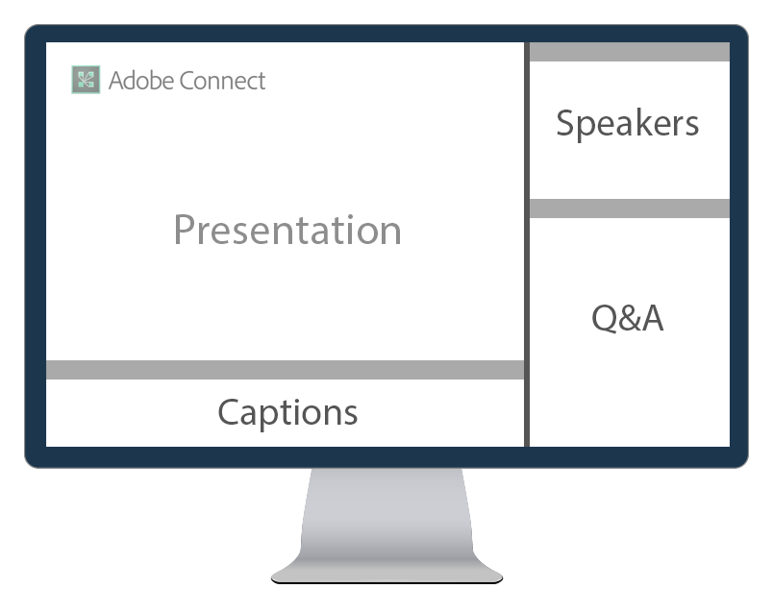
Help During the Presentation
If you need any technical assistance during this webinar, please let us know using the Q&A panel to the right of the presentation.
  You may also ask any content-related questions you may have during this presentation via the Q&A panel.

Slide 11
Closed Captioning Is Available
Closed captioning is available during this webinar. Captions will appear in the panel directly beneath the presentation.
  If you need any technical assistance with closed captions, please let us know using the Q&A panel.

Slide 12
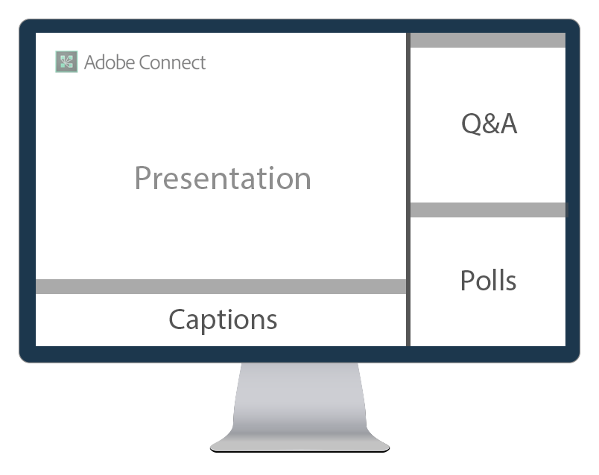
Interactive Polling
During this presentation, we will occasionally poll the audience. When polls are activated, they will appear in the panel to the lower right.
  To participate, simply select your desired response.
  You will have some time to respond to each question.

Slide 13
How many people (including you) are joining this webinar together in the same room?
1
Just me – I am the only one participating.
Two people.
Three or four people.
Five or more people.

Slide 14
Which President signed Medicare into law?
2
Richard M. Nixon.
Lyndon B. Johnson.
Dwight D. Eisenhower
Gerald Ford.
Notes:
Correct answer is B. Lyndon B. Johnson.

Slide 15

Which President signed Medicare into law? (cont.)
2
Richard M. Nixon.
Lyndon B. Johnson.
Dwight D. Eisenhower
Gerald Ford.
Notes:
Correct answer is B. Lyndon B. Johnson.

Slide 16
Who was enrolled as the very first Medicare beneficiary by President Johnson?
3
Harry S. Truman.
Claudia Alta “Lady Bird” Johnson.
Richard Nixon.
Betty Ford.
Notes:
Correct answer is A. Harry S. Truman

Slide 17
Who was enrolled as the very first Medicare beneficiary by President Johnson? (cont.)
3
Harry S. Truman.
Claudia Alta “Lady Bird” Johnson.
Richard Nixon.
Betty Ford.
Notes:
Correct answer is A. Harry S. Truman

Slide 18
What Is the LTCH QRP?
Notes:
Briefly discuss LTCH QRP.
Review the CMS Quality Goals.
Discuss LTCH QRP requirements.

Slide 19

What Is the LTCH QRP?
Section 3004(a) of the Patient Protection and Affordable Care Act of 2010 amended section 1886(m)(5) of the Social Security Act requiring the Secretary to establish quality reporting requirements for LTCHs beginning in fiscal year (FY) 2012.
In response to reporting requirements identified in the Improving Medicare Post-Acute Care Transformation (IMPACT) Act of 2014, the Centers for Medicare & Medicaid Services (CMS) required the reporting of standardized patient assessment data elements (SPADEs) by LTCHs.
Notes:
IMPACT Act - requires the submission of data pertaining to quality measure, resource use, and other domains. Using standardized quality measures and standardized data, the intent of the IMPACT Act, among other obligations, is to allow for the exchange of standardized and interoperable data among post-acute, and other, providers. The IMPACT Act intends for standardized Post-Acute Care data to improve Medicare beneficiary outcomes through shared decision-making, care coordination, and enhanced discharge planning.

Slide 20
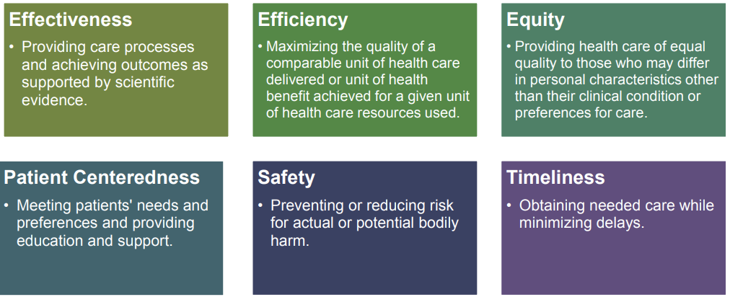
CMS Quality Goals
Quality healthcare for people with Medicare is a high priority for CMS.
CMS defines quality as having the following properties or domains:

Slide 21

LTCH QRP Requirements
The LTCH CARE Data Set (LCDS) is applicable to all patients receiving inpatient services in a facility certified as a hospital and designated as an LTCH under Medicare.
The LCDS should be completed for individual LTCH patients who are admitted to, discharged from, or die in the LTCH, regardless of length of stay.
LCDS data are required to be submitted and accepted within the threshold and according to the established submission timelines.

Slide 22
LTCH QRP Life Cycle
January 1 - December 31, 2020
(Calendar Year (CY) 2020)
During the first half of
CY 2021
FY 2022
(October 1, 2021 - September 30, 2022)
Data Collection & Submission (LCDS) | CMS Compliance Determination |  |  |  | Payment Impact APU in Effect for FY
CMS Sends Non-Compliance Letters
June/July
Non-Compliant LTCHs Complete Reconsideration Requests Within 30 Days
July/August
CMS Delivers Reconsideration Results
September
Calendar Year 2021
Notes:
Graphic representation of the entire process.

Slide 23
LCDS Submission and Reporting Requirements
Notes:
Briefly review the (LCDS) and discuss submission requirements and data submission deadlines.
Review data submission threshold.
When and where to submit data and how to ensure data has been submitted and accepted.

Slide 24
The LTCH CARE Data Set (LCDS)
The LCDS is the assessment instrument LTCH providers use to collect patient assessment data in accordance with the LTCH Quality Reporting Program (QRP).
Collection and submission of data elements on the LCDS is necessary to calculate the quality measures (QMs) as mandated by the LTCH QRP and the SPADEs and QMs specified in the IMPACT Act.
Per the IMPACT Act, the data elements in the LCDS are to be standardized and interoperable to allow for:
  Exchange of information among PAC providers and other providers.
  Access to longitudinal patient information.
  Coordination of care.

Slide 25
LCDS Submission Requirements for the LTCH QRP
LCDS Assessments must be completed and submitted for any patient admitted to a facility certified as a hospital and designated as an LTCH under the Medicare program regardless of payment/payer source, age, or diagnosis (e.g., including pediatric patients and patients with psychiatric diagnoses).
LCDS Assessments include:
  Admission Assessment.
  Planned Discharge Assessment.
  Unplanned Discharge Assessment.
  Expired Assessment.
Notes:
The LTCH CARE Data Set is applicable to all patients receiving inpatient services in a facility certified as a hospital and designated as an LTCH under the Medicare program.
Data collection using the LTCH CARE Data Set is applicable regardless of patient’s age, diagnosis, length of stay, or payment/payer source.
The LTCH CARE Data Set includes Admission, Planned Discharge, Unplanned Discharge, and Expired Assessments. These data sets are completed for individual LTCH patients who are admitted to, discharged from, or die in the LTCH.

Slide 26
LCDS Submission Requirements for the LTCH QRP (cont.)
The data for the LTCH QRP are collected and submitted through three methods:
LCDS | Centers for Disease Control and Prevention (CDC) Healthcare Safety Network (NHSN) | Medicare Fee-for-Service Claims
Used to capture data elements used in the calculation of 10 assessment-based QMs. | Data are submitted through CDC and used in the calculation of four QMs. | Provide information for three claims-based QMs. There is no additional data collection or submission required by LTCHs.
Notes:
Be clear that APU is based on the submission of the data elements used to calculate the QM’s and not on the QM's themselves.

Slide 27
NHSN Submission Requirements
For NHSN data, providers are required to report Patient Safety and Healthcare Personnel Safety data for each calendar month, with three months of data due by each submission deadline.
Submitting data within 30 days of the end of the month in which it is collected has the greatest impact on infection prevention activities.
Notes:
From NHSN: CDC/NHSN requires data submission on a monthly basis and strongly encourages healthcare
facilities to enter each month’s data within 30 days of the end of the month in which it is
collected (for example, all March data should be entered by April 30) so it has the greatest
impact on infection prevention activities.
However, for purposes of fulfilling CMS quality measurement reporting requirements, each facility’s data must be entered into NHSN no later than 4 ½ months after the end of the reporting quarter. In other words, Q1(January/February/March) data must be entered into NHSN by August 15, Q2 must be entered by November 15, Q3 must be entered by February 15, and Q4 must be entered by May 15 for data to be shared with CMS.

Slide 28
NHSN Submission Requirements (cont.)
For the purpose of fulfilling CMS quality reporting requirements, each LTCH’s data must be entered into NHSN no later than 4½ months after the end of the reporting quarter.
For summary reporting of the Influenza Vaccination Coverage Among Healthcare Personnel measure, only data from Quarter 4 of the prior year and Quarter 1 of the current year data must be entered by May 15th following each influenza season.
For all other NHSN measures, providers that submit complete data for all 12 months will be found compliant.
Notes:
From NHSN: CDC/NHSN requires data submission on a monthly basis and strongly encourages healthcare
facilities to enter each month’s data within 30 days of the end of the month in which it is
collected (for example, all March data should be entered by April 30) so it has the greatest
impact on infection prevention activities.
However, for purposes of fulfilling CMS quality measurement reporting requirements, each facility’s data must be entered into NHSN no later than 4 ½ months after the end of the reporting quarter. In other words, Q1(January/February/March) data must be entered into NHSN by August 15, Q2 must be entered by November 15, Q3 must be entered by February 15, and Q4 must be entered by May 15 for data to be shared with CMS.

Slide 29
LTCH QRP Assessment-Based QMs
Changes in Skin Integrity Post-Acute Care (PAC): Pressure Ulcer/Injury.
  Lower percentages are better.
Application of Percent of Residents Experiencing One or More Falls with Major Injury (Long Stay).
  Lower percentages are better.
Functional Outcome Measure: Change in Mobility LTCH Patients Requiring Ventilator Support.
  Displayed as change score.

Slide 30
LTCH QRP Assessment-Based QMs (cont. 1)
Percent of LTCH Patients with an Admission and Discharge Functional Assessment and a Care Plan That Addresses Function.
  Higher percentages are better.
Application of Percent of LTCH Patients with an Admission and Discharge Functional Assessment and a Care Plan That Addresses Function.
  Higher percentages are better.
Drug Regimen Review Conducted with Follow-Up for Identified Issues – PAC LTCH QRP.
  Higher percentages are better.

Slide 31
LTCH QRP Assessment-Based QMs (cont. 2)
Compliance with Spontaneous Breathing Trial (SBT) by Day 2 of the LTCH Stay.
  Higher percentages are better.
Ventilator Liberation Rate.
  Higher ratios are better.

Slide 32
LTCH QRP Assessment-Based QMs (cont. 3)
Transfer of Health Information to the Provider – PAC.
  Higher percentages are better.
Transfer of Health Information to the Patient – PAC.
  Higher percentages are better.

Slide 33
LTCH QRP Claims-Based QMs
Rate of Potentially Preventable Hospital Readmissions 30 Days After Discharge From an LTCH.
  Lower rates are better.
Rate of Successful Return to Home and Community From an LTCH.
  Higher rates are better.
Medicare Spending Per Beneficiary for Patients in LTCHs.
  Displayed as a ratio.

Slide 34
LTCH QRP NHSN QMs
Catheter-Associated Urinary Tract Infection (CAUTI) Outcome Measure.
  Lower rates are better.
Central Line-Associated Bloodstream Infection (CLABSI) Outcome Measure.
  Lower rates are better.
Facility-Wide Inpatient Hospital-Onset Clostridium difficile Infection (CDI) Outcome.
  Lower rates are better.
Influenza Vaccination Coverage Among Healthcare Personnel (HCP).
  Higher rates are better.

Slide 35
LCDS Data Submission Deadlines
There are individual LCDS data submission deadlines that must be met to be in compliance with the LTCH QRP.
The data collection year runs from January to December, and submission deadline quarters are as follows:
*This data must be reported by 11:59 p.m. local time zone on the 15th of the month or on dates specified by CMS each year.
Calendar Year Data Collection Quarter | Data Collection Submission QRP | Submission Deadline*
Quarter 1 | January 1 - March 31 | August 15
Quarter 2 | April 1 - June 30 | November 15
Quarter 3 | July 1 - September 30 | February 15
Quarter 4 | October 1 - December 31 | May 15
Notes:
The August 15 dates may differ depending on if that date falls on a holiday or weekend. CMS will provide reminders for upcoming data submission deadlines on the LTCH QRP Spotlight Announcements web page and provides FY LTCH QRP Data Collection and Final Submission Deadline documents as a download on the LTCH QRP Data Submission Deadlines web page.
FY 2022: https://www.cms.gov/files/document/ltch-qrp-data-collection-and-final-submission-deadlines-fy-2022-ltch-qrp.pdf

Slide 36

Temporary LTCH QRP Exceptions Due to COVID-19
CMS granted an exception to the LTCH QRP reporting requirements for the quarters below.
  These requirements were temporarily changed to assist LTCHs as they directed resources toward caring for patients and ensuring the health and safety of patients and staff during then COVID-19 public health emergency (PHE).
Exceptions ended
on June 30, 2020.
Quarter | LCDS Data Submission Reporting
Quarter 4 (October 1 - December 31, 2019) | Optional
Quarter 1 (January 1 - March 31, 2020) | Excepted
Quarter 2 (April 1 - June 30, 2020) | Excepted

Slide 37
Impact of LTCH QRP Exceptions Due to COVID-19 on Public Reporting
The LTCH QRP is a pay-for-reporting program; as such, CMS is statutorily required to publicly report the data.
Even though the data submission for Q4 2019 was optional, data submission was strong, so these data were included in the measure calculations for public reporting.
Data for Q1 and Q2 2020 will impact what is displayed on Care Compare for LTCHs; therefore, CMS developed a strategy to accommodate the excepted quarters of data.
Notes:
Data Submission on or after July 1:
Since the temporary exception for LTCH quality reporting requirements ended on June 30, 2020, starting on July 1, 2020, LTCHs were expected to resume timely quality data collection and submission of measure and patient assessment data for the LTCH Care Data Set and NHSN. There are no submission requirements for Medicare claims data.

Slide 38
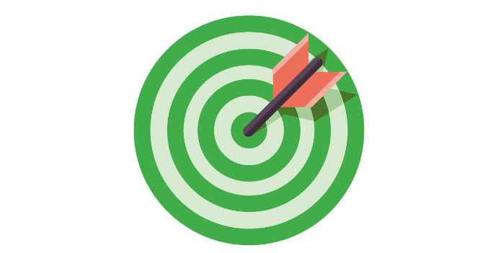

LTCH QRP Data Submission Thresholds
LTCHs must meet or exceed two separate data completeness thresholds in order to comply with the LTCH QRP.
LTCHs are required to submit LCDS data to the Internet Quality Improvement and Evaluation System (iQIES) and measures data to the CDC via NHSN.
80 Percent
Threshold for LCDS assessment data submitted that must contain 100% f the required quality data elements for the 10 assessment-based QMs.
100 Percent
Threshold for measures data
collected and submitted using CDC’s NHSN.
Notes:
LCDS Threshold – 80% of LCDS data submitted must contain 100% of the required quality data elements for the 10 assessment-based QMs.
CDC NHSN Threshold – 100% of the required NHSN measures data collected and submitted using CDC’s NHSN.

Slide 39

LTCH QRP Data Submission Thresholds (cont.)
LTCHs that fail to submit the required data by the data submission deadlines will be subject to a 2-percentage-point reduction in their APU for the affected FY.
LCDS Records From | LCDS Submission Threshold | NHSN Submission Threshold | Reporting Year
CY 2021 | 80% | 100% | FY 2023
CY 2022 | 80% | 100% | FY 2024
CY 2023 | 80% | 100% | FY 2025
Notes:
There is a 2-year delay between data collection and the affected FY application of the APU. For example, data collected in CY 2021 will be used in support of the FY 2023 APU.

Slide 40
Impact of LTCH QRP Exceptions Due to COVID-19 on Public Reporting (cont. 1)
Quarter Refresh | LTCH Compare (LTCH QRP) Assessment-Based Measures Claims-Based Measures NHSN-Based Measures
September 2020 | Continued to display June 2020 refresh data.
December 2020 | Normal refresh – included Q4 2019 data (inaugural posting of three new QMs).
March 2021 | Freeze
June 2021 | Freeze
September 2021 | Freeze
December 2021 | Public reporting resumes*
March 2022 | Normal Refresh
IMPORTANT NOTICE
All NHSN (e.g., CAUTI, CLABSI, CDI, and HCP influenza) QMs will be frozen beginning with the December 2020 refresh through the December 2021 refresh. CMS will continue to report NHSN infection data to PAC providers via their confidential provider feedback reports throughout this time.
*To account for missing PHE-excepted data (Q1 2020 and Q2 2020) when public reporting resumes, any potential change in measure calculation methodology will be subject to notice-and-comment rulemaking.

Slide 41
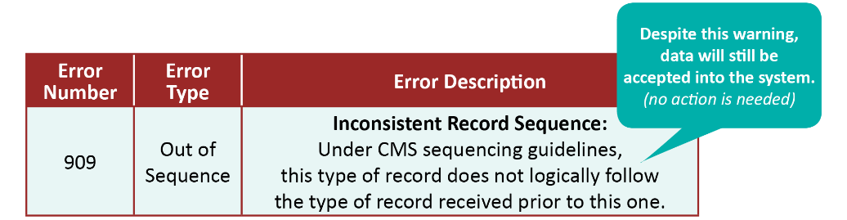
Impact of LTCH QRP Exceptions Due to COVID-19 on Public Reporting (cont. 2)
CMS is aware that some of the Discharge Assessments submitted on or after July 1, 2020, may not have a matching LCDS Admission record if the admission occurred in Q1 or Q2 2020.
This may cause an “out of sequence” warning error (909) during the submission process. Please note that despite this warning, data will still be accepted into iQIES.
CMS will make adjustments to accommodate any records with missing Admission Assessments.
These mismatched sets of records will not be counted or included in your LTCH data calculations for Care Compare.

Slide 42

LCDS Reporting Requirements
To meet LTCH QRP requirements, LTCHs must:
  Meet the LCDS data collection requirements.
  Submit LCDS data on time per submission deadlines.
  Ensure LCDS data are accepted.
The act of submitting data does not equal acceptance.
Notes:
Summary

Slide 43
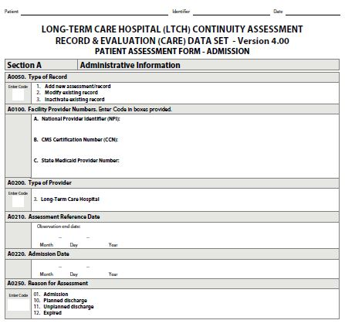
LCDS Admission Assessment
The LCDS Admission Assessment is completed for each new patient admitted to the LTCH.
There is a maximum of a 3-day assessment period in which the patient’s assessment must be conducted to obtain information for the LCDS Admission Assessment items.
The Assessment Reference Date (ARD) (A0210) must be no later than the 3rd calendar day of the patient’s admission (Admission Date (A0220) + 2 calendar days).
Notes:
– ARD (A0210) must be no later than Admission Date (A0220) + 2 calendar days.
– LTCH CARE Data Set Admission Assessment should be completed no later than ARD (A0210) + 5 calendar days (i.e., no later than Admission Date + 7 calendar days), but also may occur on, but not before, the ARD. The Completion Date is recorded in item Z0500B.
–The Submission Date should be no later than Completion Date (Z0500B) + 7 calendar days (i.e., no later than Admission Date + 14 calendar days), but also may occur on, but not before, the ARD.

Slide 44
LCDS Admission Assessment (cont.)
The Completion Date (Z0500B) should be no later than the 8th calendar day of the patient’s admission (ARD + 5 calendar days) but also may occur on, but not before, the ARD.
Submission should be no later than the 15th calendar day of the patient’s admission (Completion Date + 7 calendar days) but also may occur on, but not before, the ARD.
Notes:
– ARD (A0210) must be no later than Admission Date (A0220) + 2 calendar days.
– LTCH CARE Data Set Admission Assessment should be completed no later than ARD (A0210) + 5 calendar days (i.e., no later than Admission Date + 7 calendar days), but also may occur on, but not before, the ARD. The Completion Date is recorded in item Z0500B.
–The Submission Date should be no later than Completion Date (Z0500B) + 7 calendar days (i.e., no later than Admission Date + 14 calendar days), but also may occur on, but not before, the ARD.

Slide 45
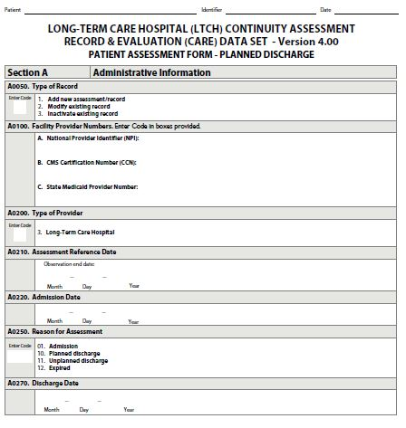
LCDS Planned Discharge Assessment
The LCDS Planned Discharge Assessment must be completed when a patient is non-emergently, medically released from care at the LTCH, for longer than 3 days, for some reason that was arranged for in advance.
The assessment period begins 2 days prior to the date of discharge, with the actual date of discharge being the end of the assessment period. However, some items (e.g., M0800) refer back to the Admission Assessment).
The ARD (A0210) must be equal to the Date of Discharge (A0270).

Slide 46
LCDS Planned Discharge Assessment (cont.)
The Completion Date (Z0500B) should be no later than Discharge Date (A0270) + 5 calendar days, and also may occur on, but not before, the ARD.
Submission must be completed no later than the Completion Date + 7 calendar days, and also may occur on, but not before, the ARD.

Slide 47
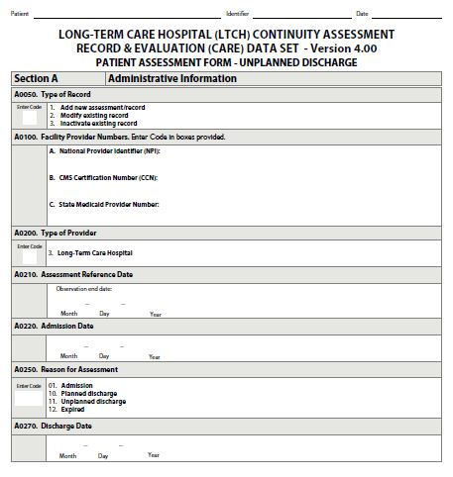
LCDS Unplanned Discharge Assessment
The LCDS Unplanned Discharge Assessment must be completed if a patient has a transfer or unplanned transfer to another hospital/facility and does not return to the LTCH within 3 calendar days. Other examples include:
  Leaving the LTCH against medical advice.
  Decision to go home or to another hospital or facility.
The assessment period begins 2 days prior to the date of discharge, with the actual date of discharge being the end of the assessment period. However, some items (e.g., M0800) refer back to the Admission Assessment).

Slide 48
LCDS Unplanned Discharge Assessment (cont.)
Due to the nature of unplanned discharges, the LTCH should complete an LCDS Discharge Assessment to the best of its ability.
ARD (A0210) must be equal to the Date of Discharge (A0270).
The Completion Date (Z0500B) should be no later than Discharge Date (A0270) + 5 calendar days, and also may occur on, but not before, the ARD.
Submission must be completed no later than the Completion Date + 7 calendar days, and also may occur on, but not before, the ARD.

Slide 49
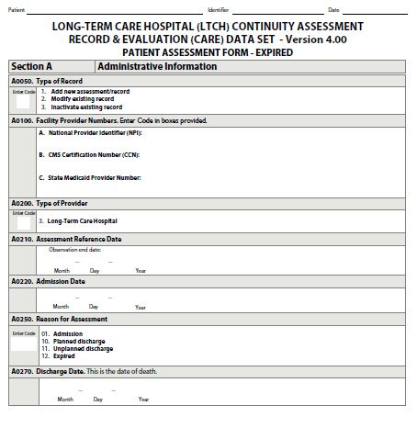
LCDS Expired Assessment
The LCDS Expired Assessment must be completed when the patient dies in the LTCH.
If the patient dies during the Admission assessment period, both an LCDS Admission and LCDS Expired Assessment must be completed.
The ARD (A0210) must be equal to the Discharge Date (A0270), which is patient’s date of death.
The Completion Date (Z0500B) should be no later than the Discharge Date (A0270 + 5 calendar days), and also may occur on, but not before, the ARD.
Submission must be completed no later than the Completion Date + 7 calendar days, and also may occur on, but not before, the ARD.

Slide 50
Interrupted Stay and LCDS Assessment Completion
Program Interruption refers to an interruption in a patient’s care given by an LTCH because of the transfer of that patient to another hospital/facility per agreement for medical services (e.g., need for acute-care services). Such an interruption must not exceed 3 calendar days.
  If a patient is returning to the LTCH after more than 3 calendar days (day of transfer + 2 calendar days) at another hospital or facility, then an LCDS Discharge Assessment related to the transfer should be competed and a new LCDS Admission Assessment should be completed.
  If a patient is returning to the LTCH after a stay at another hospital lasting less than 3 calendar days, then an LCDS Discharge Assessment related to the transfer should not be completed and a new LCDS Admission Assessment should not be completed.
  If the patient did not return to the LTCH by day 3 of the transfer, it is no longer considered an “interrupted stay,” and the LTCH should complete an LTCH CARE Data Set Planned or Unplanned Discharge Assessment, as appropriate.

Slide 51
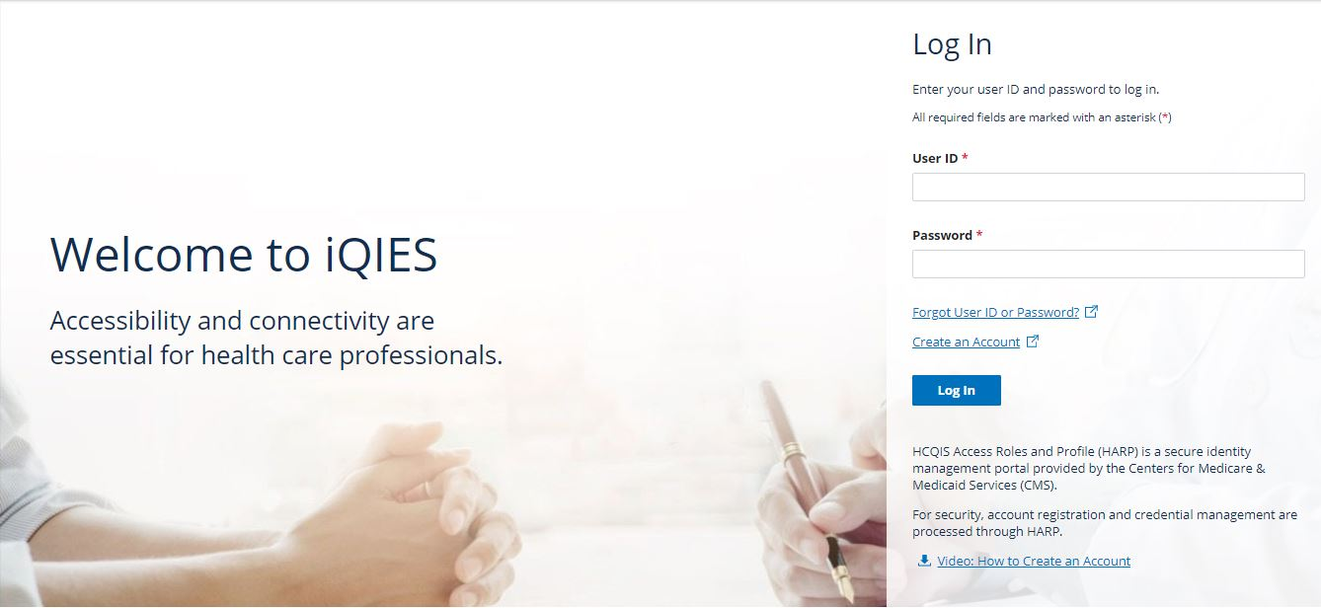
Where to Submit Data
LCDS records are submitted to CMS iQIES.
Ensure that your submissions are in the correct format, contain the correct information, and will be accepted by iQIES.
The iQIES Reports Training Guide is an important resource for providers.

Slide 52
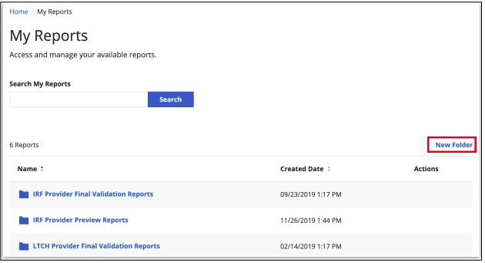
How to Ensure That Data Submitted Are Accepted
iQIES:
  Confirms that the submission was received.
  Includes the name of the file you submitted.
The submission of data does not mean the data were accepted.
The LTCH Provider Final Validation Report (FVR) will verify acceptance or rejection of LCDS records.
The FVR is the only way to verify that submitted files were also accepted.

Slide 53
Where do you submit LCDS for the LTCH QRP?
4
The Nursing Home Survey Data Center.
Centers for Disease Control and Prevention.
The Quality Manager at your agency.
iQIES.

Slide 54
Where do you submit LCDS for the LTCH QRP? (cont.)
4
The Nursing Home Survey Data Center.
Centers for Disease Control and Prevention.
The Quality Manager at your agency.
iQIES.
Notes:
Correct answer is D. The QIES ASAP System

Slide 55
iQIES Reports
Notes:
Overview of the Final Validation, Review & Correct, and Provider Threshold Reports.
How each of these reports can be used to check compliance with the LTCH QRP.

Slide 56
How to Access iQIES Reports
There are many valuable reports in iQIES.
  Select My Reports from the Reports menu dropdown to view all your saved reports, which can be organized into folders.

Slide 57

How to Access iQIES Reports (cont.)
To find a report, select Find a Report Type from the Reports dropdown menu.

Slide 58
Public Reporting
Reporting iQIES Reporting
Review & Correct Report
Provider Threshold Report
Provider Preview Report
Care Compare
QM Reports
Confidential Reporting Public Reporting

Slide 59



Final Validation, Review and Correct, and Provider Threshold Reports

Slide 60
LCDS Final Validation Report (FVR)
The FVR is automatically generated in iQIES within 24 hours of the submission of a file and placed in the provider’s My Reports folder.
Provides detailed information about the status of select submission files.
  Indicates if the records submitted were accepted or rejected.
  Details the warning and fatal errors encountered, which can include:
    Fatal File Errors.
    Fatal Records Errors.
    Warnings.
The FVR can also be user-requested.
Notes:
Displays detailed information regarding all the records for the facility contained in the submission file. The report indicates whether the records were accepted or rejected and displays the warning and fatal errors, if any, encountered.

Slide 61
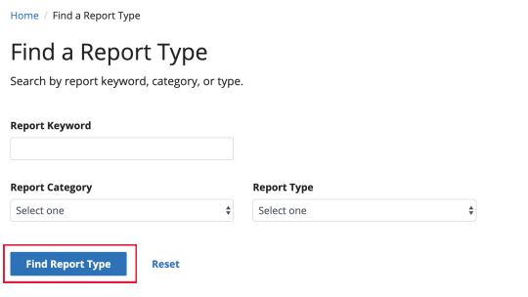
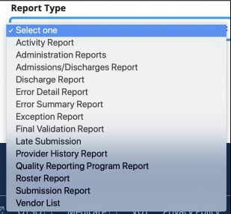
How to Access the LCDS FVR

Slide 62
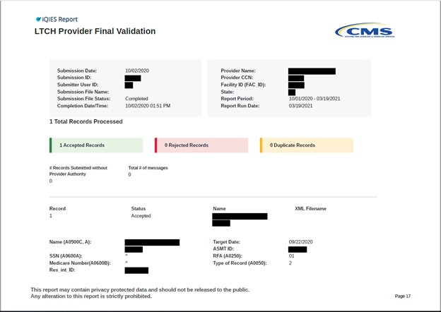
Example: LTCH Provider FVR

Slide 63
Errors and Warnings on the LTCH FVR
There are many conditions that may prevent a file or record from being successfully submitted.
The FVR outlines these errors, whether fatal or simply a warning, encountered in submitted records.
Each error or warning is noted on the report by its identifier. Section 5 of the LTCH Submission User’s Guide provides a list of all errors/warnings and includes guidance for correcting errors, if necessary: https://qtso.cms.gov/system/files/qtso/Users_Sec5_6.pdf
All fatal errors in a file or record MUST be corrected and the file or record resubmitted.

Slide 64
Fatal File Errors
Fatal File Errors: The submission file structure is checked against LCDS data submission specifications; if the file does not meet requirements, it is rejected.
  Examples of fatal file errors include:
    File is not a ZIP file.
    File cannot be read.
Files that are rejected must be corrected and resubmitted.

Slide 65
Fatal Record Errors
Each LCDS record within the file is checked for fatal record errors.
Fatal record errors include, but are not limited to, the two following types:
  Duplicate assessment.
    For example, if the submitted record is a duplicate of a previously submitted record.
  Inconsistent relationships between items.
    For example, an inconsistent date pattern, such as the Patient’s Birth Date (A0900) being in the same year as the Admission Date (A0220).

Slide 66
Fatal Record Errors (cont.)
Records with fatal errors are rejected by iQIES, and the record is not accepted.
Rejected records are not saved in iQIES.
Fatal record errors must be corrected and resubmitted to ensure that data are accepted.

Slide 67
Nonfatal Errors or Warnings
Late submission of LCDS records will result in a nonfatal (warning) error.
Records containing warnings, or nonfatal errors, can still be accepted by iQIES.
Any combination of fatal errors and nonfatal errors will be rejected and must be corrected.
Warning messages alone do not cause an LCDS record to be rejected by iQIES.
Warning messages should be reviewed to see whether the information
needs to be corrected and resubmitted.

Slide 68
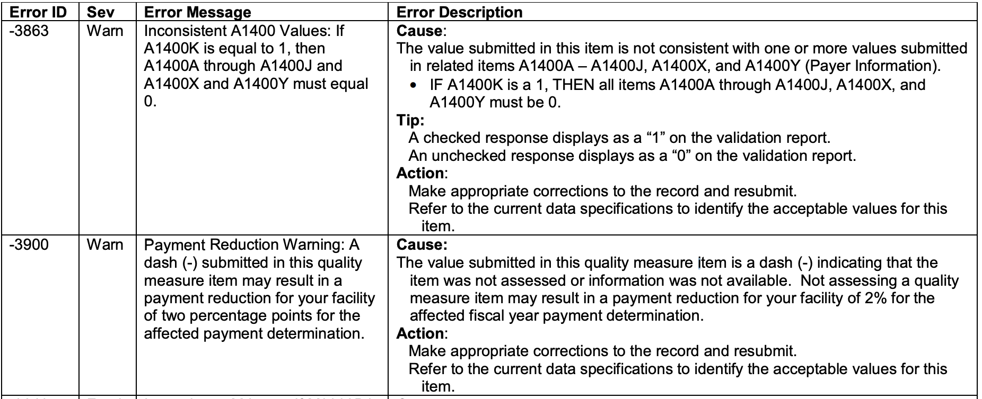
Example: Error/Warning

Slide 69
Review and Correct Report
User-requested, on-demand report.
Confidential to providers.
Provides quarterly and cumulative performance rates for assessment-based publicly reported QM data at both the patient and facility level.
  Providers are able to request by individual quality measure.
  Patient-level data is available as a comma-separated value (CSV) flat file.
Displays four most recent quarters.
  Rolling quarters: Once a new quarter is added, the oldest quarter is dropped.

Slide 70
Review and Correct Report (cont. 1)
Only observed (raw) data are provided: risk-adjusted rates are not shown.
Available for providers to run with updated data weekly (until the data correction deadline).
When reporting quarter ends, data for that reporting quarter is available the next calendar day.
Displays data correction deadlines and whether the data correction period is open or closed.
Due to the COVID-19 PHE exceptions, there will be no data
available (open) to correct for Q1 2020 and Q2 2020.
Notes:
Data freeze due to COVID affected this report: The purpose of this report is for providers to have access to quality measure data prior to the data correction deadline for public reporting. It includes data from the most current quarter “open” for data correction and data from the previous three quarters “closed” for data correction (frozen data). There will be no data available (open) to correct for Q1 2020 and Q2 2020.

Slide 71

Review and Correct Report (cont. 2)
Ability to sort patient-level data by fields such as:
  Patient last name.
  Patient first name.
  Patient status.
  Discharge date.
  Admission date.
Ability to request report by individual QM.

Slide 72
Data Collection/Correction Periods
Calendar Year Data Collection Quarter | Data Collection Submission QRP | Quarterly Review and Correction Periods*
Quarter 1 | January 1 – March 31 | April 1 – August 15
Quarter 2 | April 1 – June 30 | July 1 – November 15
Quarter 3 | July 1 – September 30 | October 1 – February 15
Quarter 4 | October 1 – December 31 | January 1 – May 15
* Data correction deadlines are for data that are used to calculate the publicly reported measures and are not applied to the confidential QM reports.
Due to the COVID-19 PHE exceptions, there will be no data available (open) to correct for Q1 2020 and Q2 2020.
.
Notes:
Data correction deadlines are for date that are used to calculate the publicly reported measures and are not applied to the confidential QM reports.
There will be no data available (open) to correct for Q1 2020 and Q2 2020 due to the COVID-19 PHE exceptions.

Slide 73
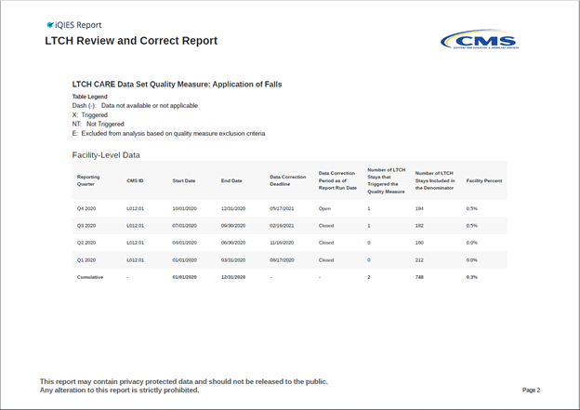
Example: Review and Correct Facility-Level Data

Slide 74
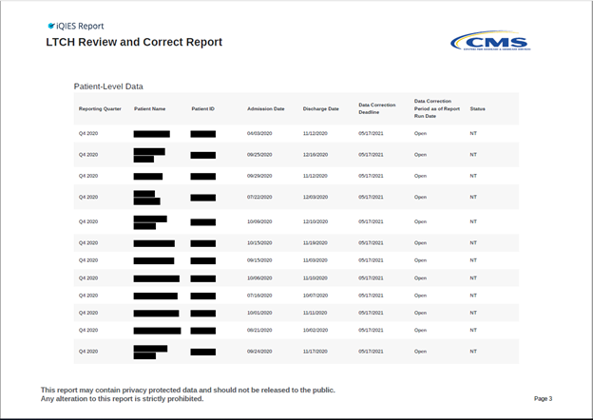
Example: Review and Correct Patient-Level Data

Slide 75
LTCH Provider Threshold Report (PTR)
The LTCH Provider Threshold Report (PTR) allows providers to monitor their compliance status of the required data submission for the LTCH QRP measures for the current APU by FY.
It is user-requested, on-demand.
The LTCH PTR will display an asterisk (*) for future dates (monthly and quarterly) when a measure is active but data are not available yet.
Notes:
LTCH QRP Provider Threshold Report allows providers to monitor their compliance status of the required data submission for the LTCH Quality Reporting Program (QRP) measures for the current Annual Payment Update (APU) by fiscal year.

Slide 76
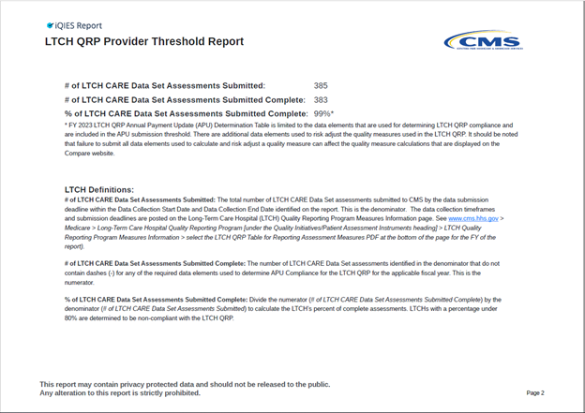
Example: LTCH PTR

Slide 77
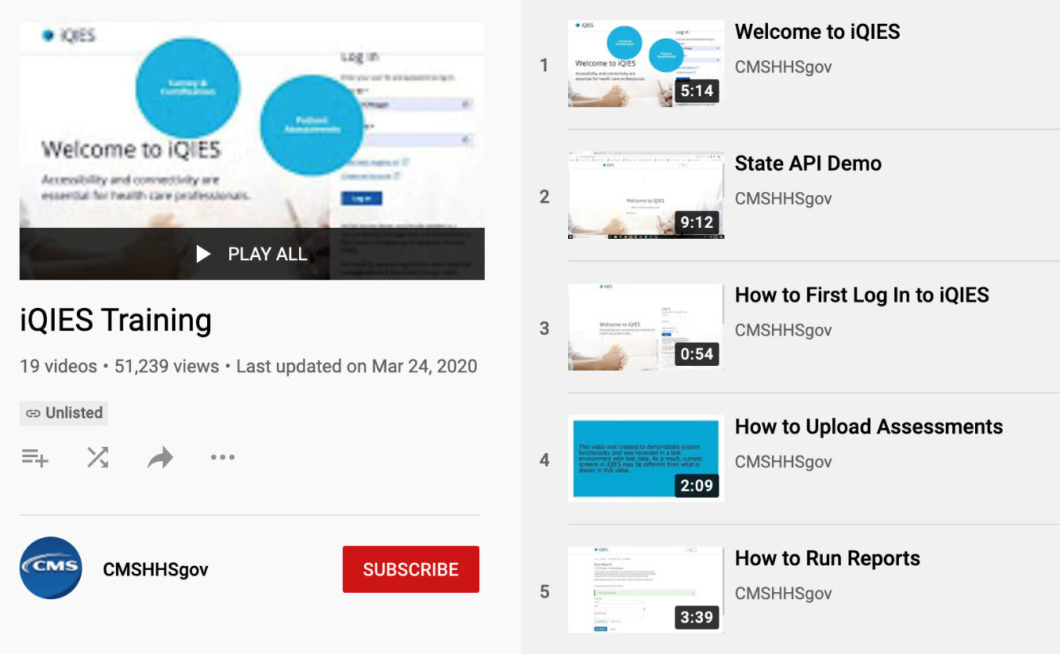
iQIES Reports Training
To learn more about these reports and other iQIES functionalities, refer to the iQIES Training YouTube playlist.
https://www.youtube.com/playlist
Notes:
Could move this to the resources section.

Slide 78
Which report provides detailed information about the status of select submission files?
5
LCDS Final Validation Report.
LCDS Error Summary by Provider Report.
Review and Correct Report.
Provider Threshold Report.

Slide 79
Which report provides detailed information about the status of select submission files? (cont.)
5
LCDS Final Validation Report.
LCDS Error Summary by Provider Report.
Review and Correct Report.
Provider Threshold Report.
Notes:
The correct answer is A. LTCH Final Validation Report.

Slide 80
Which of the following statements regarding the Review and Correct Report is false?
6
Can be requested on-demand.
Is confidential to providers.
Provides only facility-level QM data.
Displays four most recent quarters of data.

Slide 81
Which of the following statements regarding the Review and Correct Report is false? (cont.)
6
Can be requested on-demand.
Is confidential to providers.
Provides only facility-level QM data.
Displays four most recent quarters of data.
Notes:
Correct answer is C. Review and Correct Reports provide both facility- and patient-level data.

Slide 82
Determining Compliance With the LTCH QRP
Notes:
Review of the LTCH QRP Lifecycle from submission of data to application of the APU
(Jan-Dec submit data; June-July informed if non-compliant/starts reconsideration timeframe; July-Aug reconsideration; Late Aug/Sept providers informed of reconsideration results; Oct 1 APU implemented for that year)
Relationship between quality reporting and APU
Overview of compliance:
CMS Determinations – non-compliance letters
Reconsideration Process – Submission of reconsideration request
APU Implementation

Slide 83
LTCH QRP LCDS Compliance
For the purposes of calculating compliance with the LTCH QRP, LCDS submissions for the calendar year are reviewed against the requirements of the LTCH QRP.
LTCH QRP requirements include:
  Submission and acceptance of an LCDS Admission Assessment followed by either a Planned Discharge Assessment, an Unplanned Discharge Assessment, or an Expired Assessment.
  LCDS are required to be submitted by established quarterly deadlines.
  80% of the assessments received must contain 100 percent of the data required to calculate the LTCH QRP QMs.

Slide 84
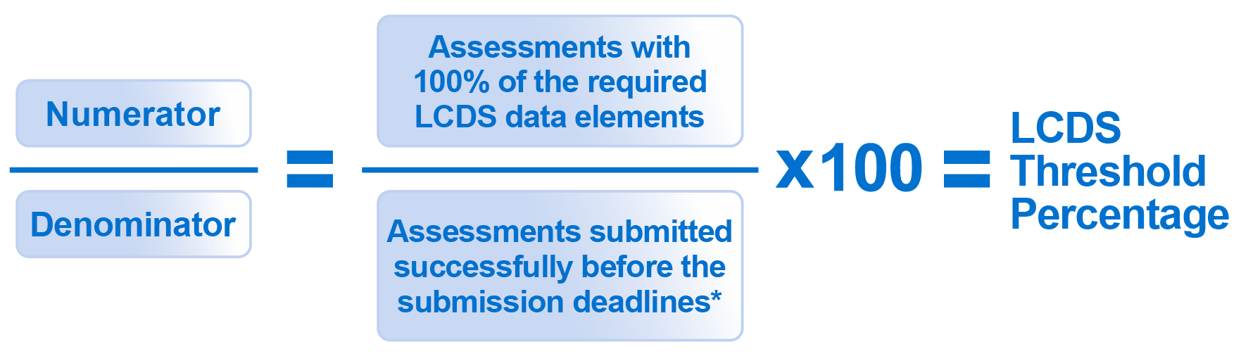
LCDS Threshold Calculation
*Note: The calculation algorithm will be adjusted in the event that an LTCH was granted an extension or exemption by CMS.

Slide 85
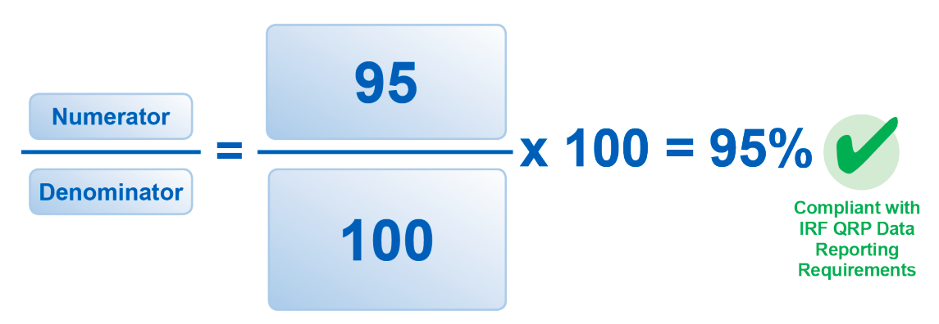
LCDS Threshold Calculation Example
Compliant with LTCH QRP LCDS Data Reporting Requirements

Slide 86
LTCH QRP NHSN Compliance
For NHSN data, providers are required to report data for each calendar month, with three months of data due by each quarterly submission deadline.
Providers must report any instances of healthcare-associated infections (HAIs) for the required measures (including reporting a zero (0) if no infections occurred), summary data, and reporting plan(s).
Providers that submit complete data for all 12 months will be found compliant for the NHSN measures*
* For submission of the Influenza Vaccination Coverage Among Healthcare Personnel measure, only data from Q4 of the prior year and Q1 of the current year must be entered by May 15th following each influenza season.
NHSN LTCH QRP data submission deadlines occur quarterly.

Slide 87

LTCH QRP Non-Compliance
Any LTCH that does not meet the requirements of the LTCH QRP will be considered non-compliant and subject to a 2-percentage point reduction in their APU for the applicable FY.
In June–July, CMS issues notices of non-compliance in at least one of two ways:
  Letter from their Medicare Administrative Contractor (MAC) via the U.S. Postal Service or email.
  Non-Compliance Notification folders in iQIES.
This notice will include the reason(s) for non-compliance and instructions for requesting reconsideration of CMS’ decision.
Notes:
Only those providers that are found non-compliant for each fiscal year will receive a notification. If there is no notice in the facility’s folder, that means they were compliant for that fiscal year.

Slide 88
What is Reconsideration?
Reconsideration is a request for review of the initial CMS compliance determination for a given LTCH for a given FY.
If a LTCH has been identified for the 2-percentage point payment reduction in APU, they have the right to request a reconsideration of the non-compliance decision.

Slide 89

Why Would a LTCH Submit a Reconsideration Request?
LTCHs may file for reconsideration if:
  They believe CMS finding of non-compliance is in error.
  They have evidence of the impact of extraordinary circumstances that prevented timely submission of data.
Requests must be submitted within 30 days of the date documented on the non-compliance notification letter.
No requests will be accepted after the 30-day deadline.
Notes:
LTCHs must receive a notice of non-compliance in order to file a reconsideration.

Slide 90
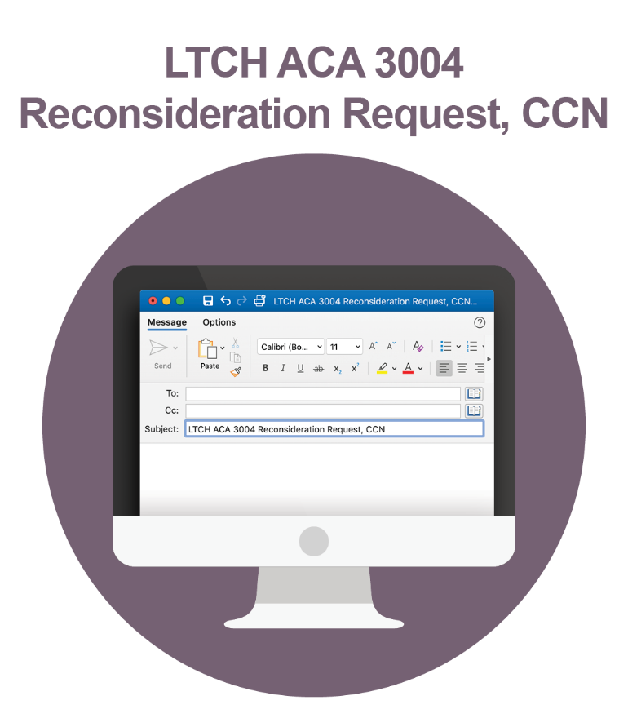
Creating a Reconsideration Request
The only method for submitting a reconsideration request is via email to CMS.
The subject line of the email should include “LTCH ACA 3004 Reconsideration Request” and the LTCH's CMS Certification Number (CCN).
The Reconsideration Request must be sent to the following email address:
  LTCHQRPReconsiderations@cms.hhs.gov

Slide 91
Creating a Reconsideration Request (cont. 1)
The following must be included in the request:
  The CCN, business name, and address.
  The CEO or designated contact information.
  The CMS-identified reasons(s) for non-compliance (from the notification letter).
  The reason(s) for requesting reconsideration.
  Information supporting the LTCH’s belief that either the finding of non-compliance is in error or they have evidence of the impact of extraordinary circumstances which prevented the timely submission of data.

Slide 92
Creating a Reconsideration Request (cont. 2)
Include supporting documentation demonstrating compliance, such as:
  Proof of submission.
  Email communications.
  Data submission reports from iQIES.
  Proof of previous waiver approvals for exception or extension for the reporting timeframe.
  Copy of the CCN activation letter.
  Other documentation supporting the rationale for seeking reconsideration.

Slide 93
Creating a Reconsideration Request (cont. 3)
Determination will be made based solely on the documentation provided.
CMS will not contact the LTCH to request additional information or to clarify incomplete or inconclusive information.
Reconsideration requests that contain protected health information (PHI) will not be processed.
IMPORTANT NOTICE
Do not submit protected PHI to CMS for review.

Slide 94
Reconsideration Response
CMS should acknowledge receipt of the reconsideration request within 5 business days through an email.
Following its review of the request and supporting documentation, reconsideration request decisions are distributed by the MAC and the reconsideration contractor.
If the decision upholds the finding of non-compliance, a provider may file an appeal with the Provider Reimbursement Review Board.
Notes:
The reconsideration contractor will distribute their notification in a trackable way – that is via FedEx or US Postal Service with tracking.

Slide 95
Reconsideration Process: Do’s and Don’ts
Do:
  Send reports demonstrating compliance with all PHI redacted.
  Submit your reconsideration request prior to the deadline.
  Ensure that you receive an email confirmation of receipt in addition to the automated response from the mailbox.
Don’t:
  SUBMIT PHI.
  Submit an email that is larger than 20 MB.
  Submit reports from third-party vendors.

Slide 96
Reconsideration Process: Estimated Timeline
June–July: Non-compliant LTCHs that failed to meet QRP requirements are notified.
July–August: Reconsideration requests are due to CMS no later than 30 days from the date on the notification of non-compliance.
  CMS provides an email acknowledgement within 5 business days upon receipt of reconsideration request.
September: CMS notifies LTCHs of the decision on reconsideration requests.
October: APU penalty imposed on LTCHs found to be non-compliant with QRP requirements.

Slide 97
Annual Payment Update (APU)
CMS annually updates the Medicare fee-for-service prospective payment rates provided to LTCHs that are billing MACs for services provided to Medicare beneficiaries. This is called the LTCH APU.
This APU occurs on a FY basis, on October 1.
LTCHs that do not meet the reporting requirements of the LTCH QRP are subject to a 2-percentage point reduction in their APU.

Slide 98
Which of the following statements regarding the reconsideration process is false?
7
LTCHs have 30 days to submit a reconsideration request.
CMS will contact the LTCH if it has further questions.
Requests can only be sent by email.
CMS issues a decision via a letter from the MACs and CMS.

Slide 99
Which of the following statements regarding the reconsideration process is false? (cont.)
7
LTCHs have 30 days to submit a reconsideration request.
CMS will contact the LTCH if it has further questions.
Requests can only be sent by email.
CMS issues a decision via a letter from the MACs and CMS.
Notes:
The false response is B. CMS will contact the LTCH if it has further questions.
Rationale: As we discussed on an earlier slide:
Determination will be made based solely on the documentation provided.
CMS will not contact the LTCH to request additional information or to clarify incomplete or inconclusive information.

Slide 100
Relationship Between Quality Reporting and APU: LTCH QRP Life Cycle
January 1 - December 31, 2020
(CY 2020)
During the first half of
CY 2021
FY 2022
(October 1, 2021 - September 30, 2022)
Data Collection & Submission (LCDS) | CMS Compliance Determination |  |  |  | Payment Impact APU in Effect for FY
CMS Sends Non-Compliance Letters
June/July
Non-Compliant LTCHs Complete Reconsideration Requests Within 30 Days
July/August
CMS Delivers Reconsideration Results
September
Calendar Year 2021
Notes:
Graphic representation of the entire process.

Slide 101
Resources

Slide 102
Resources
The LTCH QRP webpage:
  https://www.cms.gov/Medicare/Quality-Initiatives-Patient-Assessment-Instruments/LTCH-Quality-Reporting/index
LTCH CARE Data Set 4.0 webpage:
  https://www.cms.gov/Medicare/Quality-Initiatives-Patient-Assessment-Instruments/LTCH-Quality-Reporting/LTCH-CARE-Data-Set-and-LTCH-QRP-Manual
LTCH Reconsideration and Exception & Extension webpage:
  https://www.cms.gov/Medicare/Quality-Initiatives-Patient-Assessment-Instruments/LTCH-Quality-Reporting/LTCH-Quality-Reporting-Reconsideration-and-Exception-and-Extension
CMS Resources for NHSN Users: CMS Requirements | NHSN | CDC

Slide 103
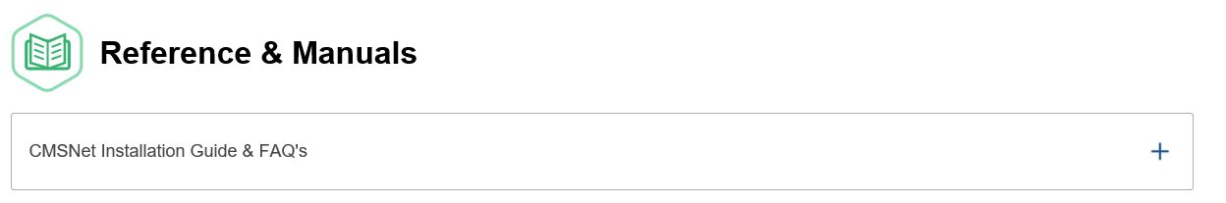
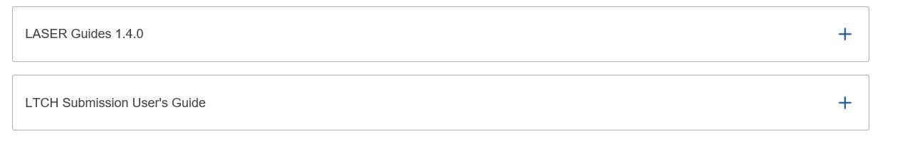
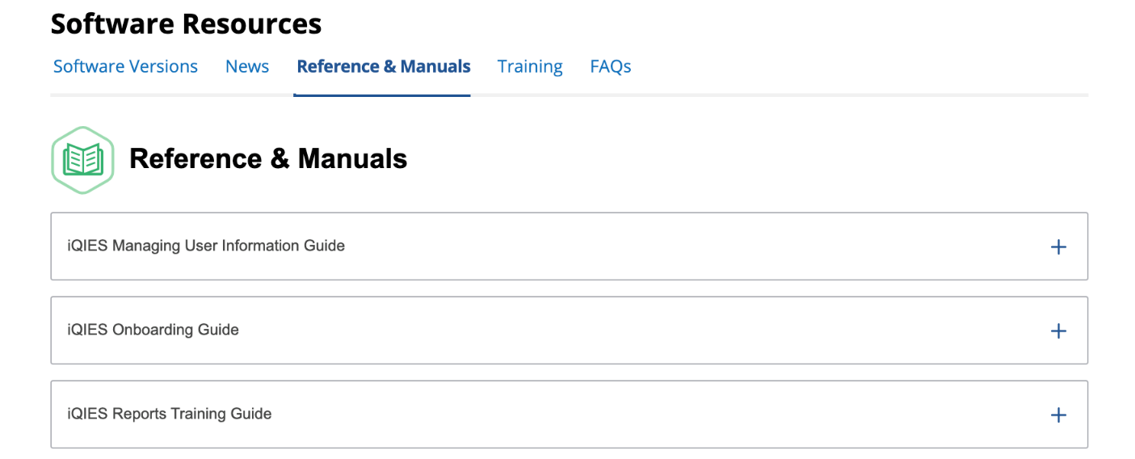
Resources (cont.)
The LTCH Submission User’s Guide provides detailed information about submission of the LCDS to iQIES.
  Available at the LTCH Providers Reference & Manuals page on the iQIES Technical Support Office (QTSO) website: https://qtso.cms.gov/providers/long-term-care-hospital-ltch-providers/reference-manuals
The iQIES Reports Training Guide provides information on reports available.
  Available at the iQIES Software Reference & Manuals webpage: https://qtso.cms.gov/software/iqies/reference-manuals

Slide 104
Help Desk Assistance
LTCH QRP Help Desk: LTCHQualityQuestions@cms.hhs.gov
LTCH QRP Public Reporting Help Desk: LTCHPRquestions@cms.hhs.gov
iQIES Help Desk: iqies@cms.hhs.gov
QTSO Help Desk: Help@QTSO.com
LTCH Reconsiderations Help Desk: LTCHQRPReconsiderations@cms.hhs.gov
APU Compliance Outreach: QRPHelp@swingtech.com

Slide 105
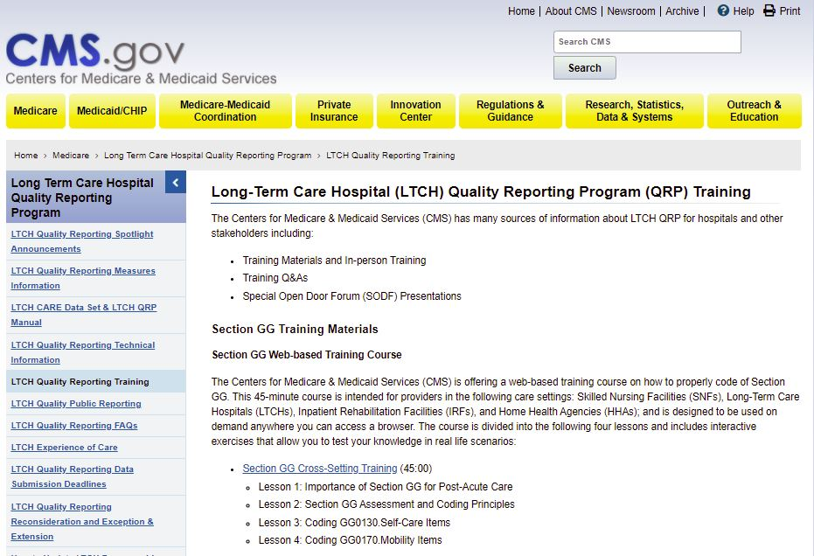
Previous Trainings
LTCH QRP Training webpage:
  https://www.cms.gov/Medicare/Quality-Initiatives-Patient-Assessment-Instruments/LTCH-Quality-Reporting/index

Slide 106
Notes:
Moderated Q&A Session (potentially using Q&A prepared from most recent Help Desk questions relating to LTCH QRP, APU, etc.).

Slide 107
Thank You.
The webinar has now concluded.

